Slide 1
SPREP at SIDS

Slide 2
SIDS was a real SPREP Team Effort

Slide 3
SPREP Team
SPREP delegation of 29 accredited staff.
10 staff also accredited to 8 country delegations: CKI, RMI, FSM, Niue, Fiji, Tonga, NZ, and Palau.
Despite the challenges of UNDESA limiting the number of participants most staff were able to get special side event passes to the main SIDs venue.

Slide 4
SPREP Involvement
Side Events - 15
Parallel Events - 8
Executive Bilateral Meetings - 25
Launches – 5
Signing of agreements – 5
In total SPREP was thus involved in 58 events (at least)
IT’S NO WONDER WE FELT OVERLOADED

Slide 5
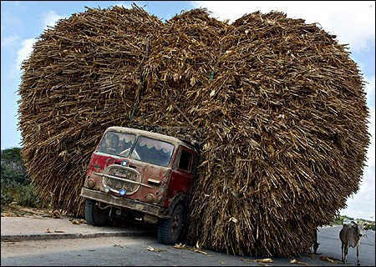

Slide 6
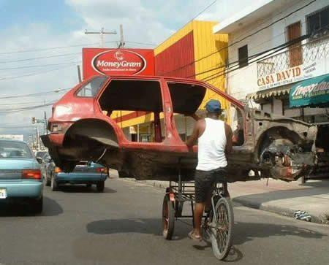

Slide 7
Partnerships (Source: http://www.sids2014.org/index.php?menu=1589)
Total SIDS Conference registered partnerships of 297
SPREP had 50 partnerships registered with SIDS. Second equal most partnerships with UNDP (50) behind UNEP (60)
We need to ensure these partnerships are both achievable and relevant to our Strategic and Workplan

Slide 8
SIDS Stats (Source: http://www.sids2014.org/index.php?menu=1589)
SPREP was one of 86 UN/IGO
Member states 186
22 Heads of State and 94 Ministers
Major Groups and Other Stakeholders 1,287
Total stakeholders at SIDS 1,564

Slide 9
SPREP at Plenary

Slide 10
SPREP Team at the Display Booth

Slide 11
PACWaste Preparing for a Bilateral

Slide 12
Signing of Agreements and MoUs

Slide 13
€5 million Project Signing with Government of Germany

Slide 14
IRC Project Signing under FINPAC

Slide 15
SIDS Highlights

Slide 16
UNEP Sub-Regional Office Launch
Mr. Achim Steiner and Hon. Tuilaepa S. Malielegaoi, Prime Minister of Samoa

Slide 17
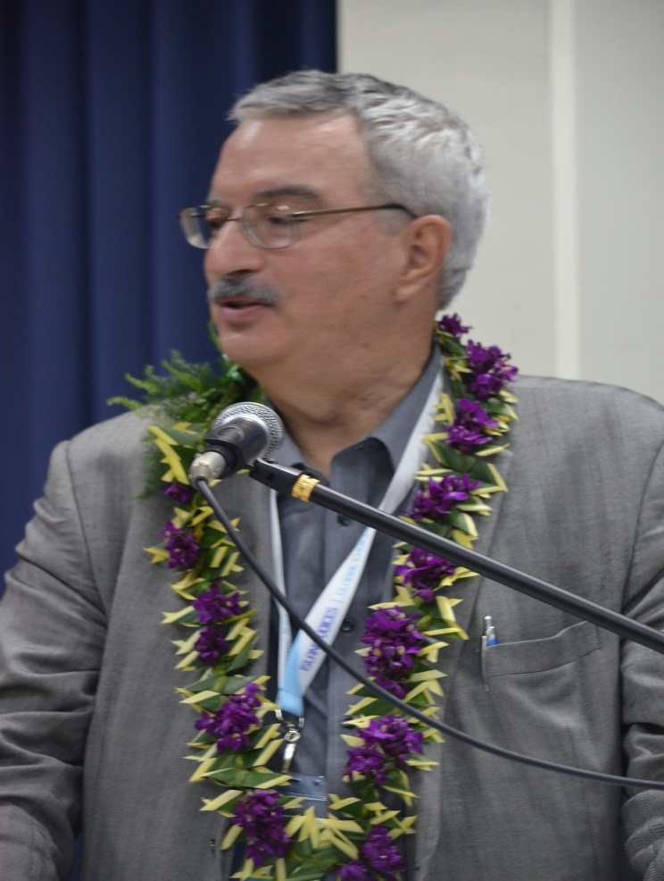
Launch of the PIRT by CBD Executive Secretary, Dr. Braulio Ferreira de Souza Dias

Slide 18
Framework Launched

Slide 19
Kosi at the Renewable Energy Forum

Slide 20
SIDS Pathway to a Green Economy

Slide 21
Guests to SPREP
HE. Madame Cynthia Ligeard, President of New Caledonia talking with Mr. Kaveh Zahedi of UNEP

Slide 22
Guests to SPREP
Hon. Tony de Brum, Minister of Foreign Affairs for Marshall Islands

Slide 23
Guests to SPREP
Dr. Shamsad Akhtar, UN Under-Secretary General and Executive Secretary for ESCAP

Slide 24
Professor Al Binger, expert panelist, key person behind SIDS DOCK, and Espen’s best friend
Signing of SIDS DOCK Sustainable Energy Treaty

Slide 25
Media Training

Slide 26
Great work with Caribbean and Indian Ocean colleagues
Sefa expert panelist and expert colleague from the Caribbean

Slide 27
Partnerships with Samoa to Prevent Marine Pollution

Slide 28
Boom at Vaisigano River

Slide 29
PACC Vital Harbours
Hon. Henry Puna, Prime Minister with Mac Mokoroa of the Cook Islands, Neta, Peni, Naheed, and Gabor of UNDP

Slide 30
Neta expert panelist

Slide 31
iCLIM Side Event

Slide 32
Expert Panel with BBC journalist David Eades

Slide 33
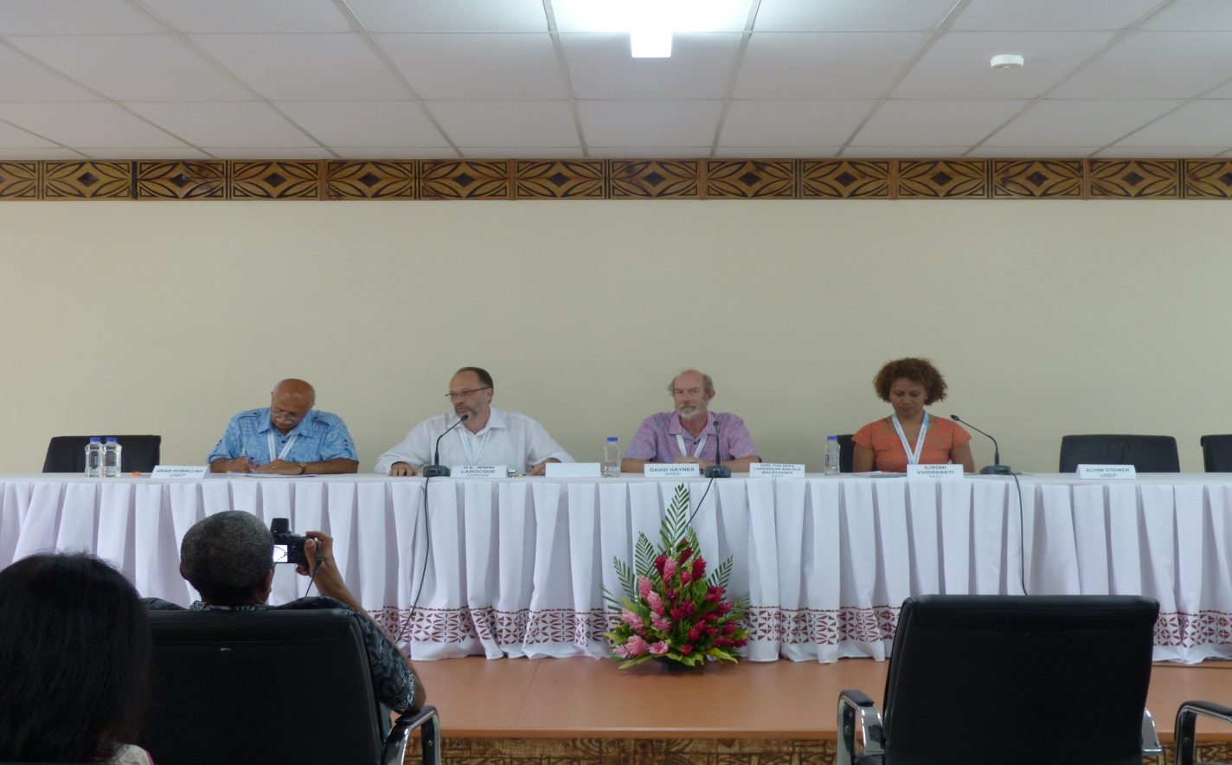
Promoting Sustainable Consumption
David Haynes expert panelist

Slide 34
Nansen Initiative Side Event

Slide 35
Choiseul Integrated Climate Change Programme
Hon. Manasseh Maelanga, Deputy Prime Minister and
Dr. Melchior Mataki of the Solomon Islands

Slide 36
Pacific Sharks with WWF

Slide 37
Ocean Acidification Workshop

Slide 38
Our Partners

Slide 39
Key SIDS documents
SAMOA Pathway
http://www.sids2014.org/content/documents/358A-CONF-223-5%20ENGLISH.pdf
Side Event Reports
http://www.sids2014.org/index.php?menu=1596
Parallel Event Reports
http://www.sids2014.org/index.php?menu=1597
Major Groups & Other Stakeholders Outcomes Document
http://www.sids2014.org/content/documents/403MG_OS_31%20Aug_Final.pdf
Youth Forum Outcomes Document
http://www.sids2014.org/content/documents/406SIDS%202014%20PRE%20CONFERENCE%20FORUM%20OUTCOME%20DOCUMENT%20-%20FINAL.pdf
SPREP-Tok Special Bulletin
https://www.sprep.org/attachments/Publications/Newsletters/SIDS-Tok.pdf

Slide 40
IMPLICATIONS FOR SPREP
Everyone had a very positive impression of Samoa and of SPREP and its programmes
There were many opportunities which we need to identify and take advantage
Main potential funding opportunities include:
German Government (EbA and Oceans)
GEF (Renewable Energy and ABS, as well as existing work)
USAID (expansion of our work on EbA in SI and Kiribati
NZ and US (Ocean Acidification)
France (linked with Climate Convention COP in 2015)

Slide 41
Some surfers may be a little flaky, but they care about water quality. How can we work with them?

Slide 42
OTHER POINTS
Excellent use made of SPREP campus for many events and ensuring SPREP was Party Central (Thanks Social Club
Next steps: (a) feedback today; (b) short report on SIDS; (c) follow up by staff on specific partnerships and opportunities; (d) team brainstorm on key issues: RE and Oceans – all interested are invited; (e) review of partnerships listed on web site
Overall, it was a great team effort. As Jason Brenden from US State dept. said: “What a week SPREP had during SIDS”

Slide 43
THANK YOU
Special thank you to all of OUR STAFF who through your various roles, whether behind the scenes or in front, made the SIDS a memorable occasion – for SPREP, our Members and our Partners!

Slide 44
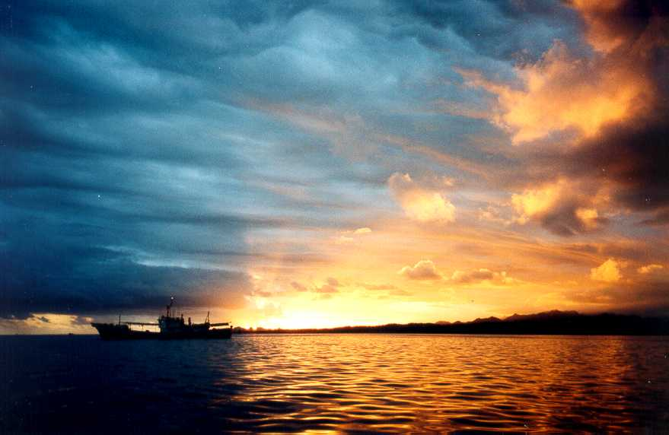
THANK YOU

