Slide 1

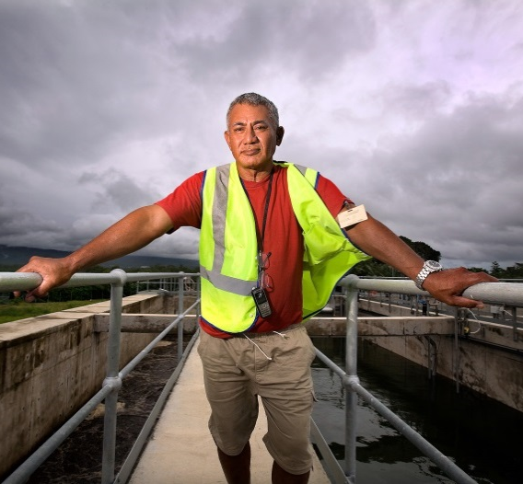
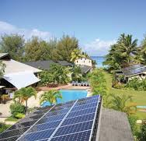
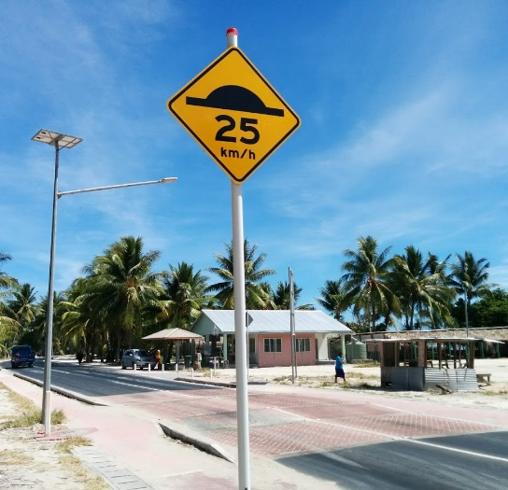
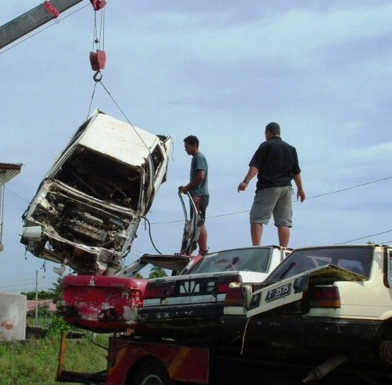

Pacific Region
Infrastructure Facility
PRIF is a multi-development partner coordination, research and technical facility which supports infrastructure development in the Pacific

Slide 2
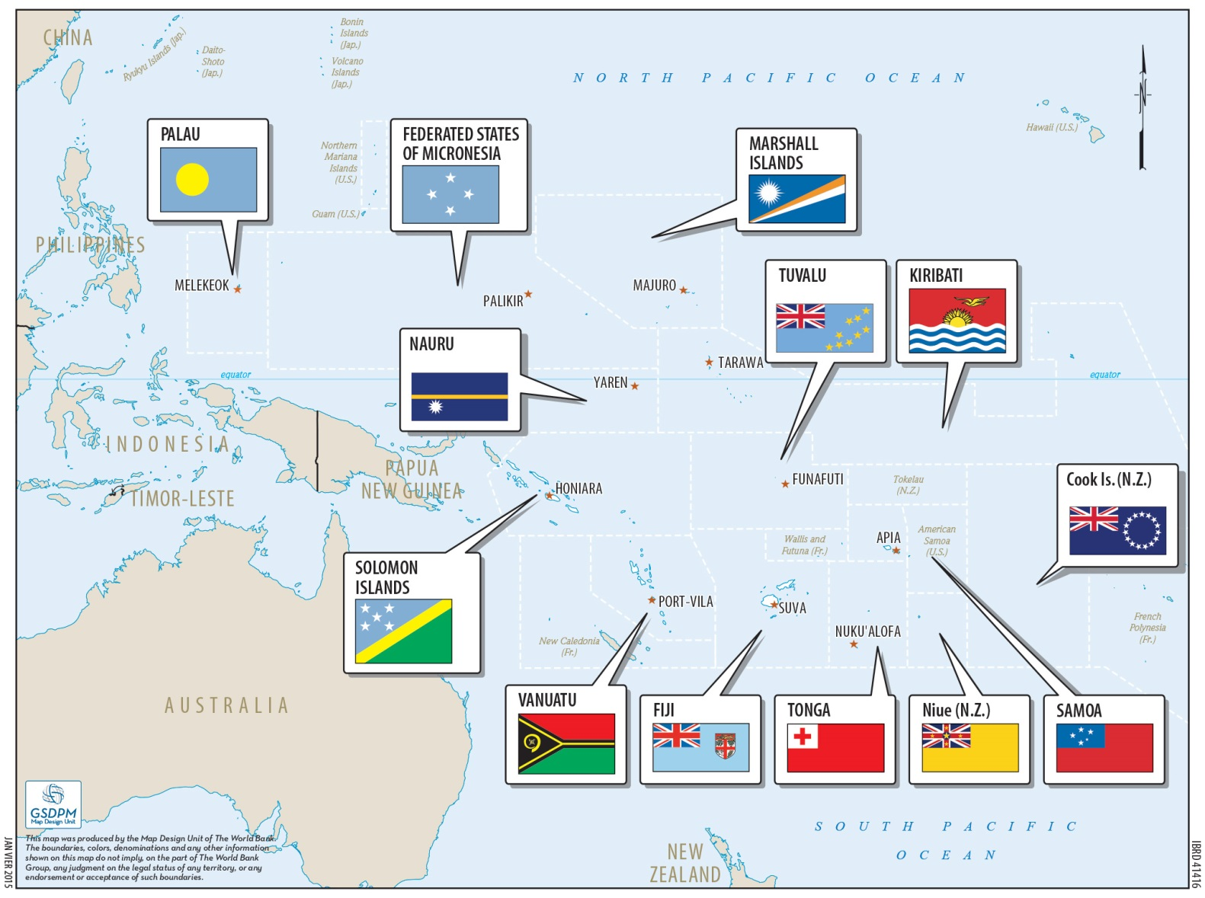

Slide 3
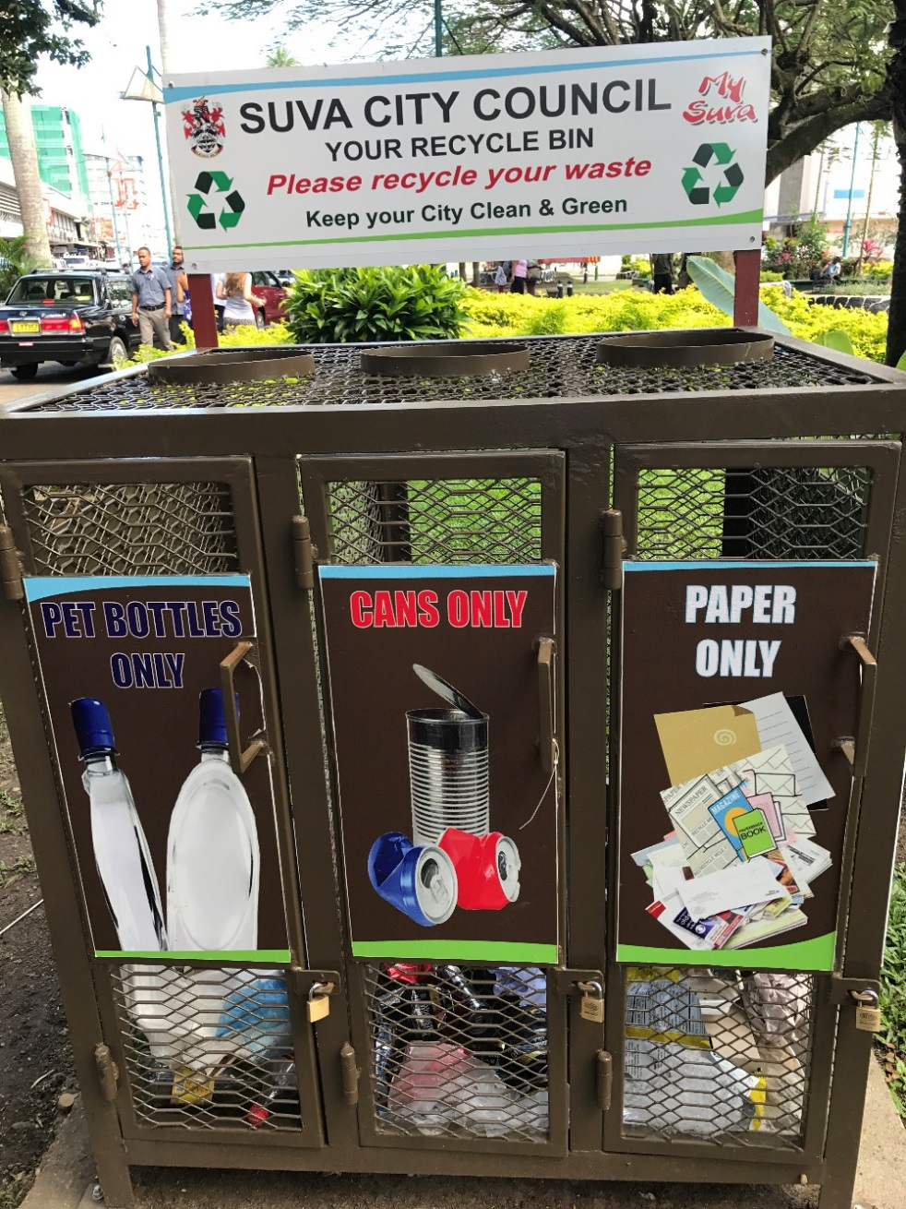
Pacific Region Infrastructure Facility
Regional Review of Solid Waste Management

Slide 4
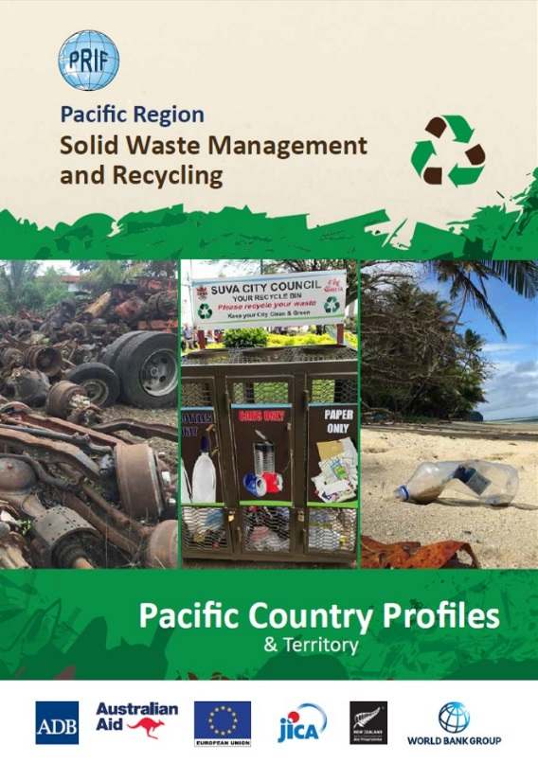
Research phase..
PRIF study 2017/2018
to identify and quantify the opportunity to improve the resource recovery of 15 recyclable commodities present in the solid waste stream in 15 Pacific island countries and territories.

Slide 5
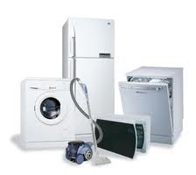


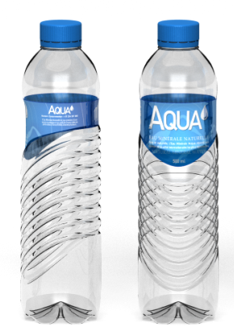
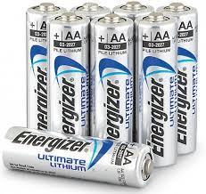

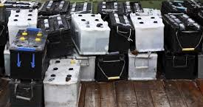
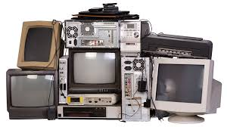

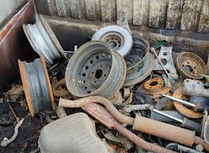


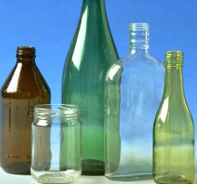
Material scope

Slide 6
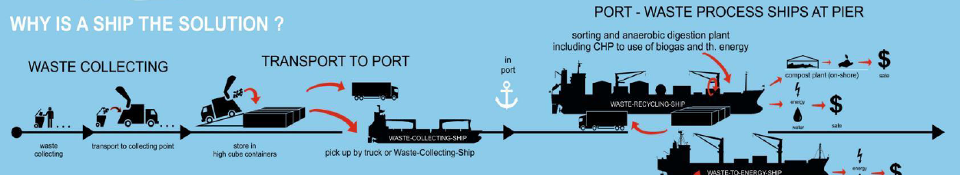
..an integrated
regional
Network ?
Commercial
shipping options = $
Swire / CNCo offer
- Free shipping from certain ports for certain commodities.

Slide 7
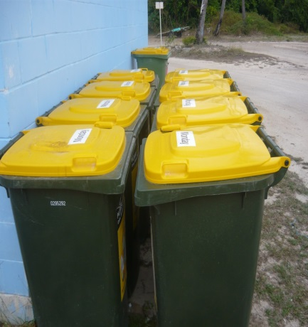
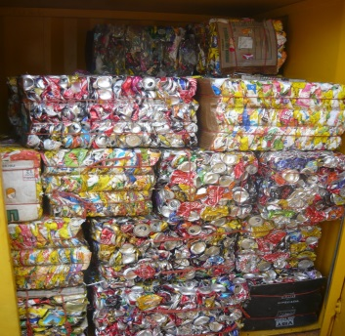
What are the infrastructure requirements?

Slide 8
..and to export ? from where? to where ?

Slide 9
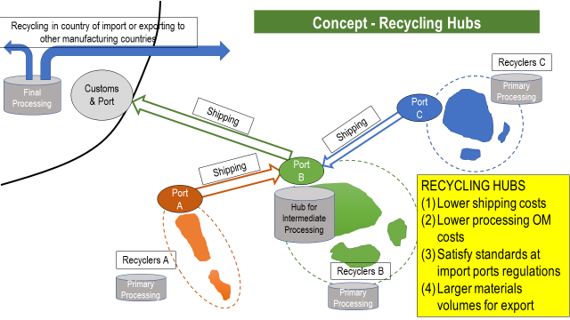
What would a Pacific Regional Network scheme look like ?

Slide 10
Waste Audits
Develop data collection methodology
Verify the research phase
Reduce error
Collect data for the scoping study

Slide 11
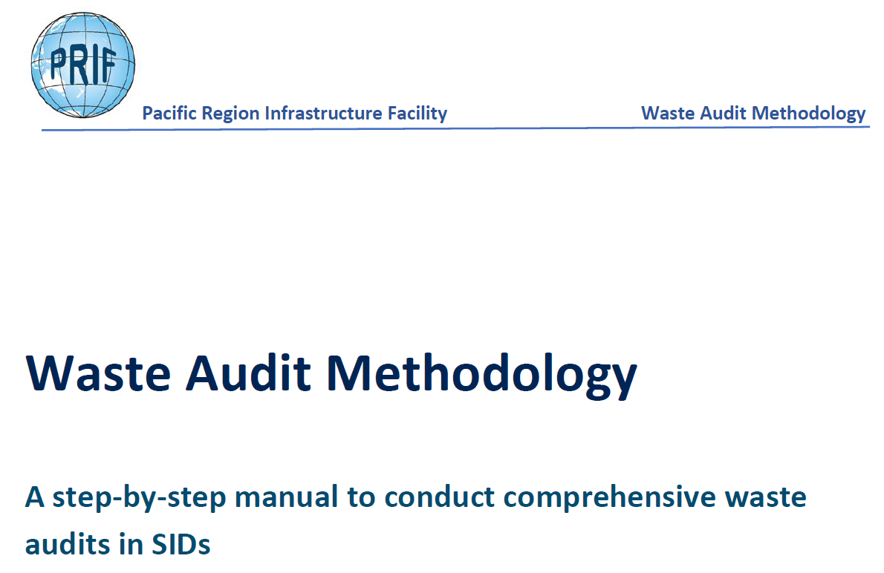
Waste Audit Methodology
Will be available soon in PRIF website (www.theprif.org)

Slide 12
Scoping: Pacific Regional Network
Objective
Establish a multi-country feeder network for recyclables and a regional processing / recycling / trans-shipment hub facility.
Next step
Scoping study to establish a ‘pilot’ recycling network in one region to prove viability and sustainability. Determine feasibility of a regional processing, trans-shipment and recycling hub, suitable urban centre facilities, and scaled outer island storage facilities in each of the Pacific island countries associated with the network.
Proposal based on detailed assessment of port facilities, capacity, shipping networks and other economic aspects. The regional hub facility would receive shipments of a selected range of recyclable waste materials from a network of source countries in the region.
The hub would be designed as a circular economy enterprise - to supply current / future remanufacturing enterprises, and to aggregate and add value to shipments of recyclables to other destinations.

Slide 13
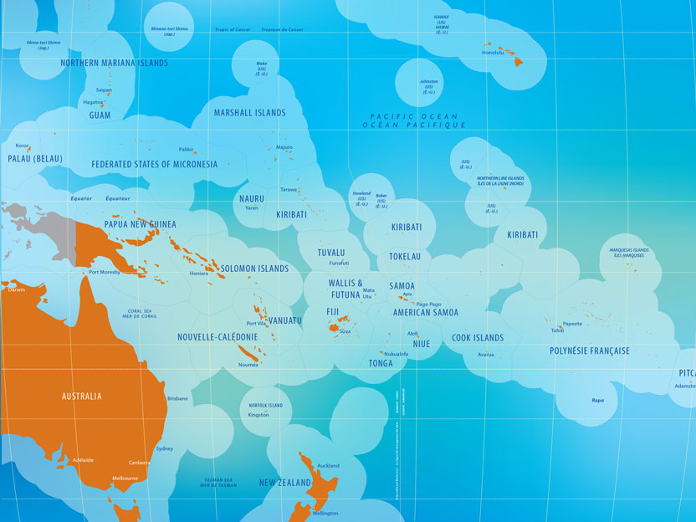





Pacific
Waste
Audits
2018-2020
AFD project in development with SPREP
JPRISM II program
in close cooperation with:
Commonwealth Clean Oceans Alliance
EU / SPREP /PacWastePlus

