Slide 1

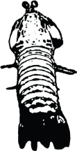


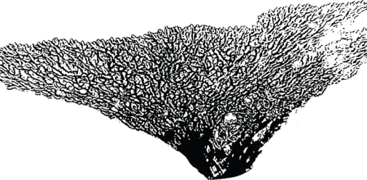







Review of Benthic Substrates for Micronesia’s Coral-Reef Monitoring Programs Using Coral Reef Point Count Software

Slide 2
Focus of presentation
To help identify and become comfortable with the most common benthic substrates from photo-quadrat data used by monitoring programs
Not focused on identifying coral genera, see other materials for coral taxonomy
Focused upon common substrates other than corals that are good indicators of reef ‘condition’
Can be expanded upon later, send recommendations for what to include

Slide 3
Examples of common benthic substrates other than corals

Slide 4
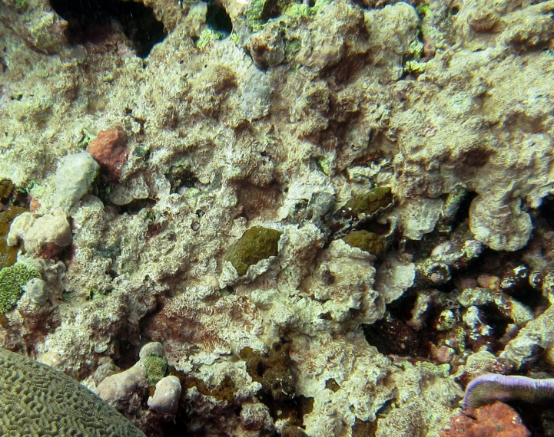
CCA
Crustose coralline algae
  Reef cementers, help glue reef structure together, heavily calcified
  Many coral larvae shown to preferentially settle on CCA versus other substrates
  Hydrolithon, Porolithon, and Titanoderma are some key genera
  Typically lighter shades of pink and purple
  CCA are most often associated with healthy reefs (+)

Slide 5
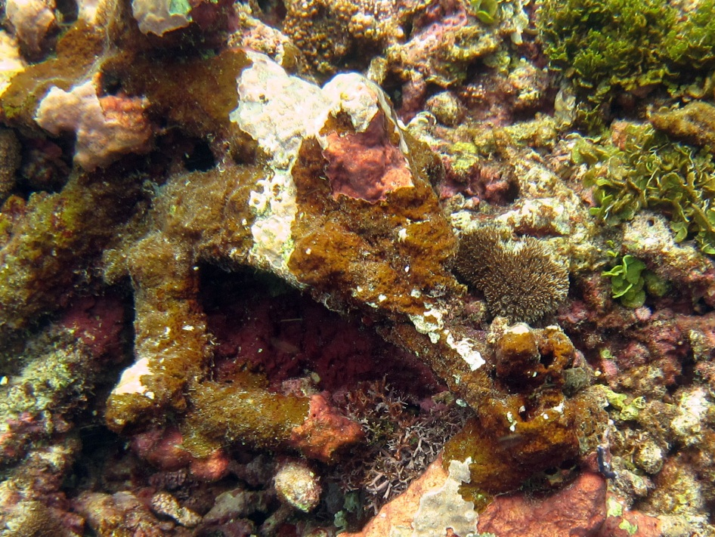
FCA
Fleshy coralline algae
  Less influential reef cementers, often only partially calcified
  FCA have been shown to shed their outer epidermal layer when coral larvae try and settle
  FCA known for more rapid lateral growth, wih the ability to shade even adult coral colonies
  Peyssonnelia and Pneophyllum are some key genera
  Typically darker shades of pink, purple, brown, or mottled
  FCA are known to be more abundant on unhealthy reefs (-) in comparison to CCA

Slide 6
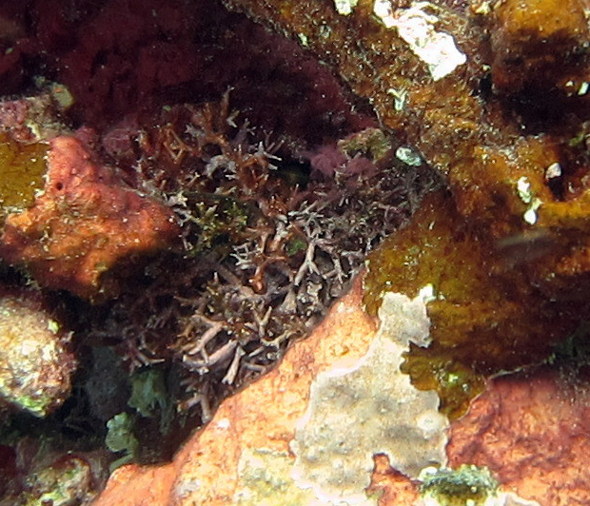
BCA
Branching coralline algae
  Heavily calcified branching algae, typically found around inner reef habitats and lagoons
  Neogoniolithon and Porolithon some key genera for BCA species
  Can be mistaken for coral growth, most notably Pocillopora damicornis, but pink/white color is distinguishing
  BCA are not fully considered to be (+) or (-) indicators to healthy reefs, for now we consider neutral

Slide 7
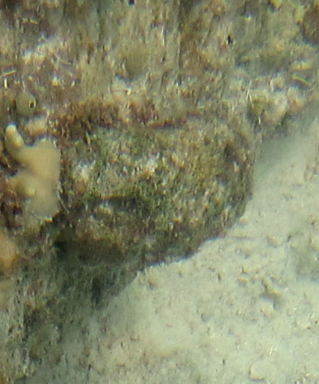
Turf
Turf algae
  Comprised mainly of microalgae often belonging to the family Gelidiaceae
  However, all erect algal substrates less than 2 cm in height are typically classified as turfs
  Typically looks like fuzzy substrate of varying color (dark browh, green, and red are most common)
  Macroalgae greater than 2 cm in height are typically classified by genus in coral point count software

Slide 8
Some examples of photographs analyzed from Pohnpei
Note
  No two people will score every data point the same every time
  However, on average similar scoring of benthic substrates should exist

Slide 9
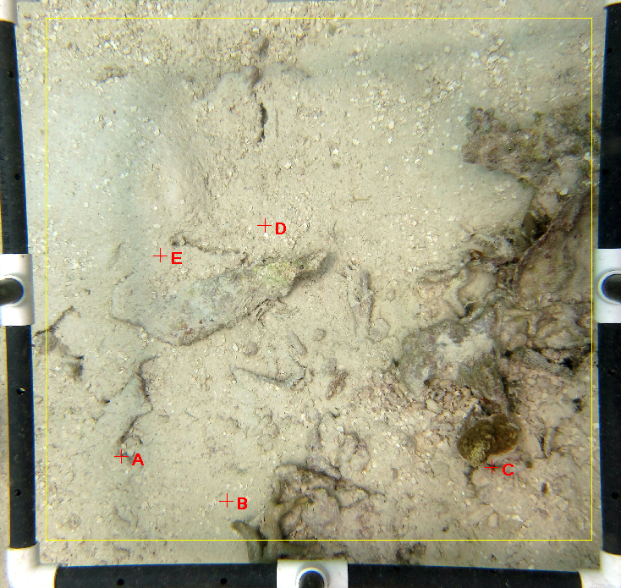
Sand
Sand
Sand
Sand
Turf

Slide 10
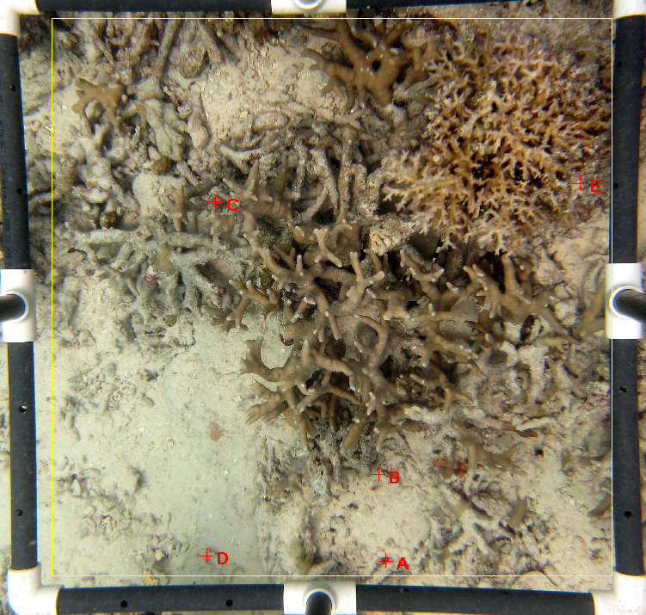
Turf
CCA
Turf
Sand
Turf

Slide 11
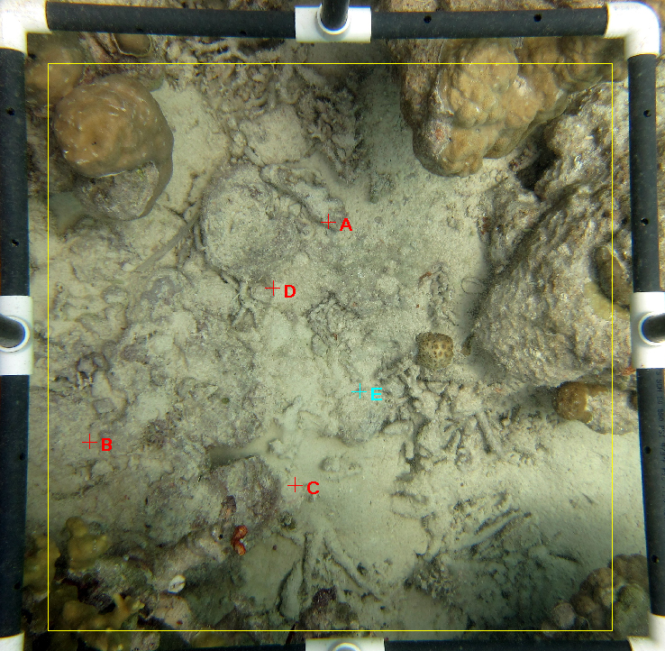
Sand
Turf
Turf
Turf
Sand

Slide 12
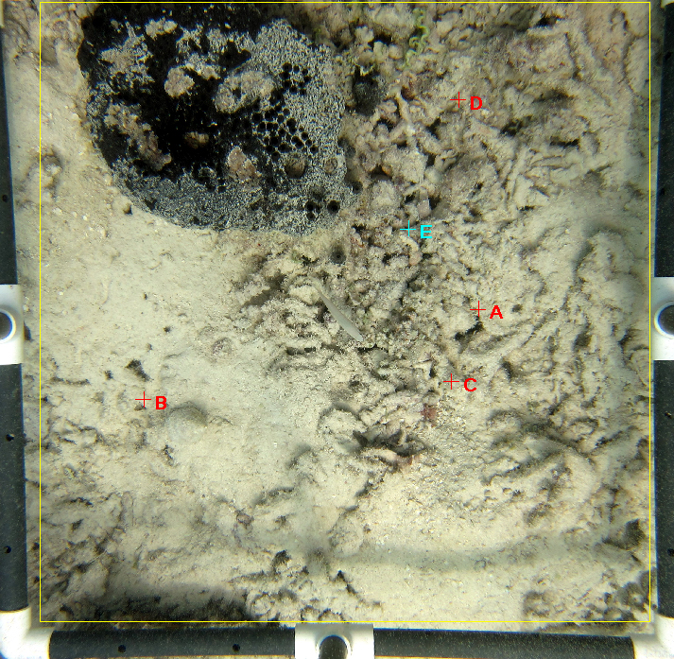
Sand
Sand
Sand
Sand
Sand

Slide 13
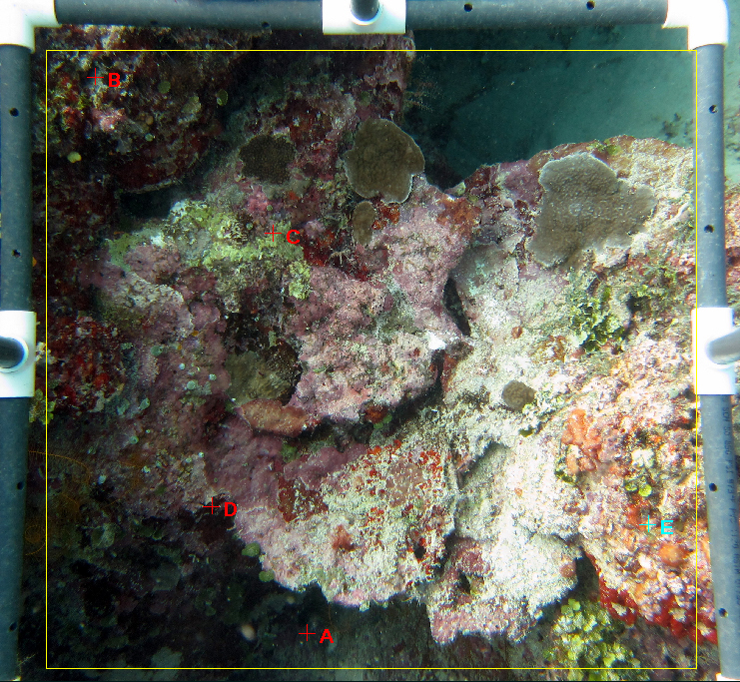
CCA
FCA
FCA
CCA
FCA

Slide 14
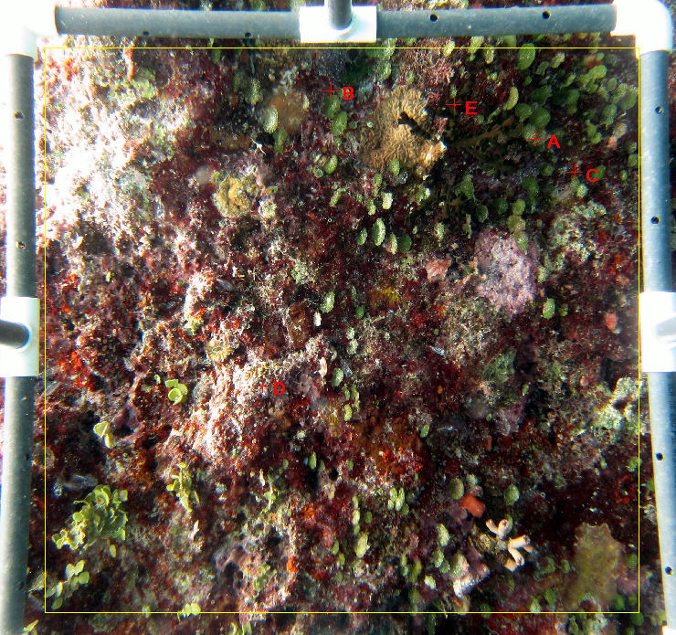
FCA
UDOTEA
FCA
FCA
CCA

Slide 15
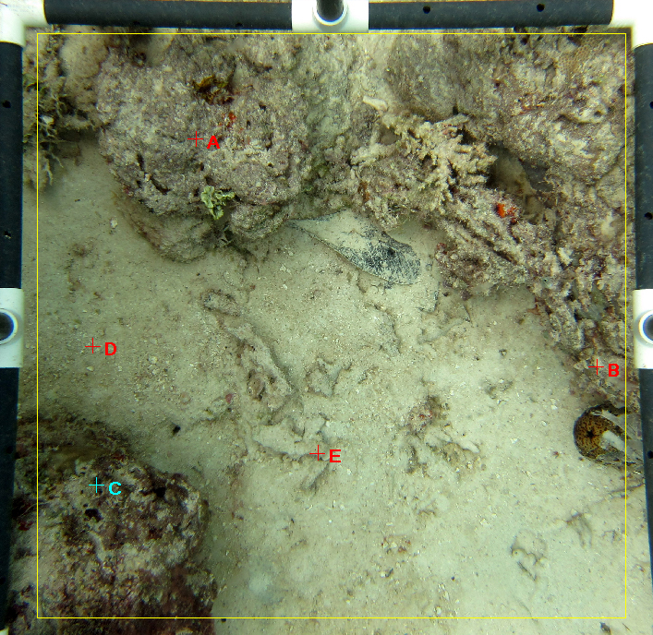
CCA
Sand
CCA
Sand
FCA

Slide 16
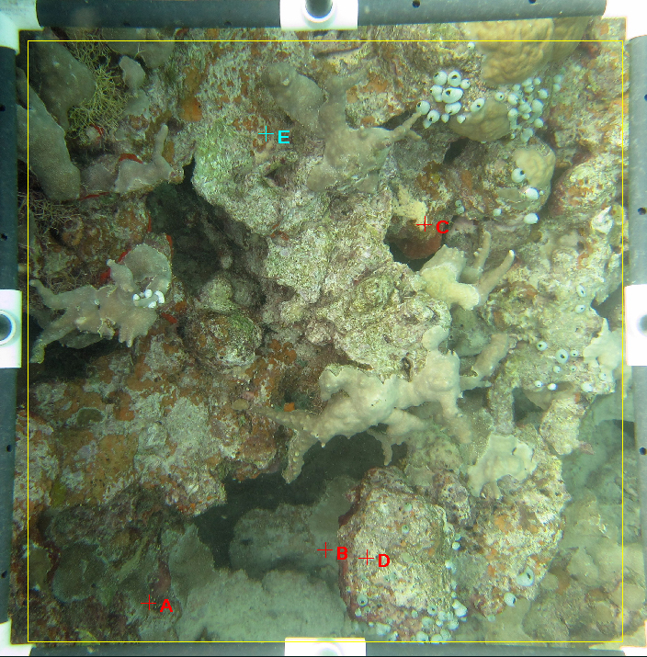
FCA
CCA
Sand
Turf
FCA

Slide 17
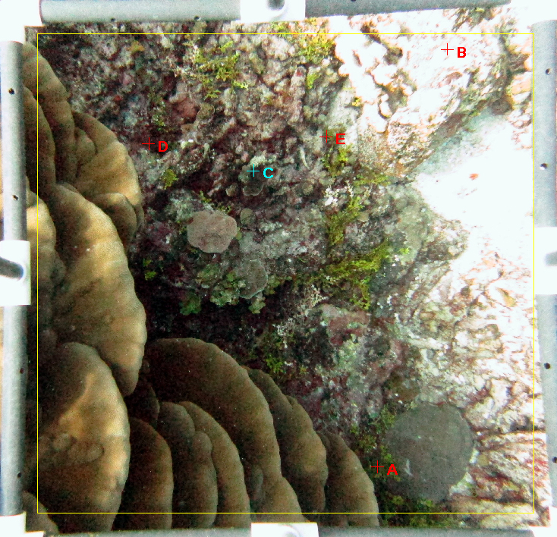
CCA
FCA
Halimeda
FCA
Halimeda

Slide 18
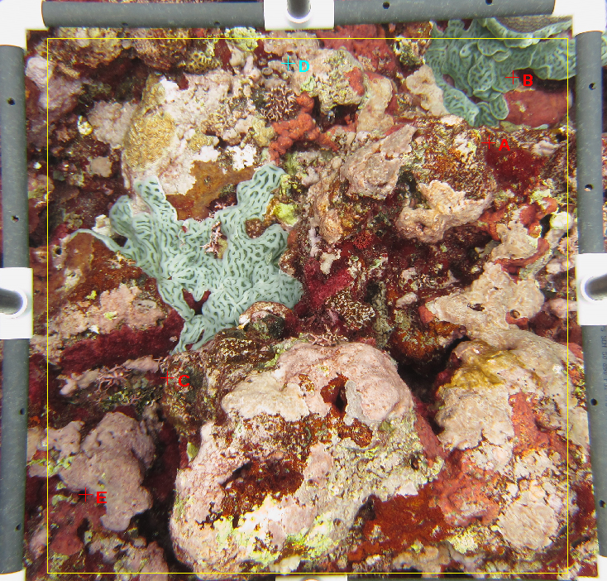
CCA
Ascidian
FCA
CCA
FCA

Slide 19
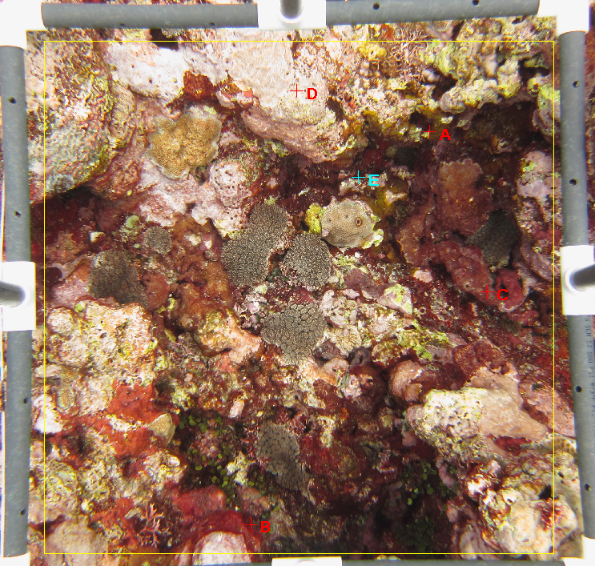
CCA
FCA
FCA
FCA
FCA

Slide 20
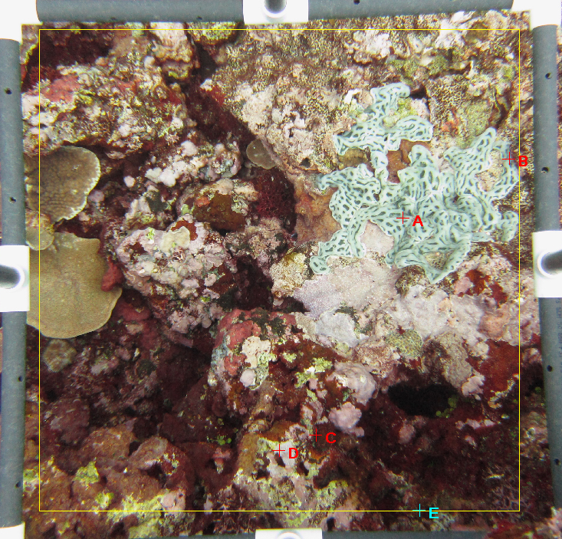
Ascidian
Ascidian
FCA
CCA
FCA

Slide 21
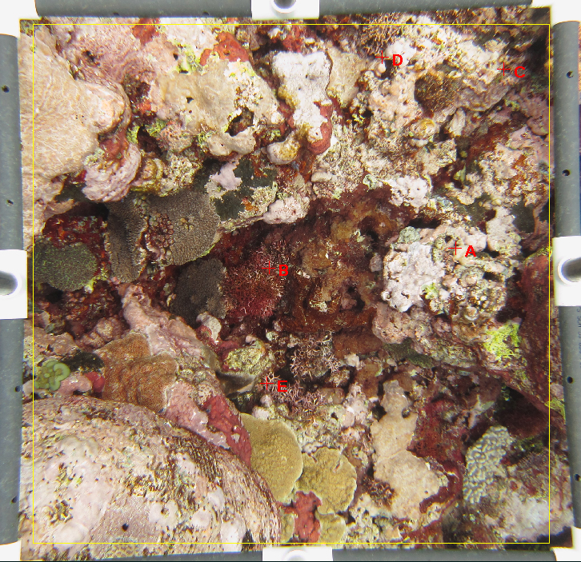
CCA
CCA
CCA
BCA
BCA

Slide 22
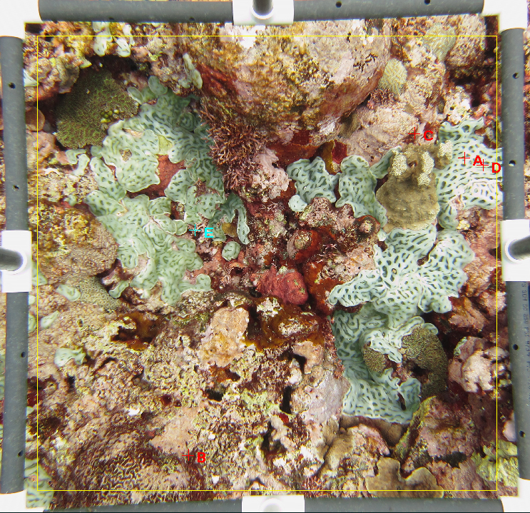
FCA
Ascidian
Ascidian
BCA
FCA

Slide 23
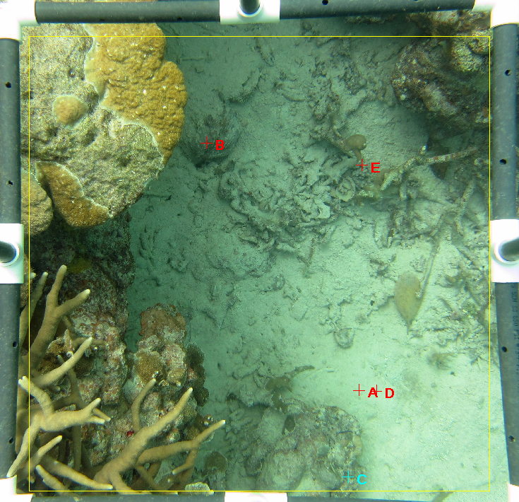
CCA
Turf
Sand
Sand
Turf

Slide 24
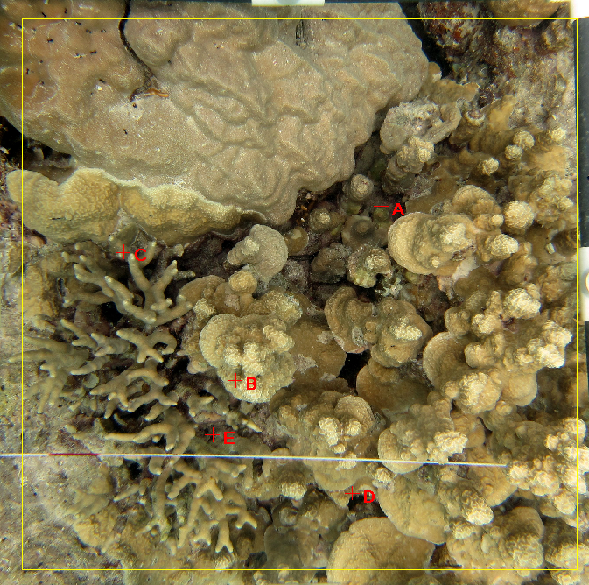
Porites rus
Porites cylindrica
Porites rus
Porites cylindrica
Porites rus

Slide 25
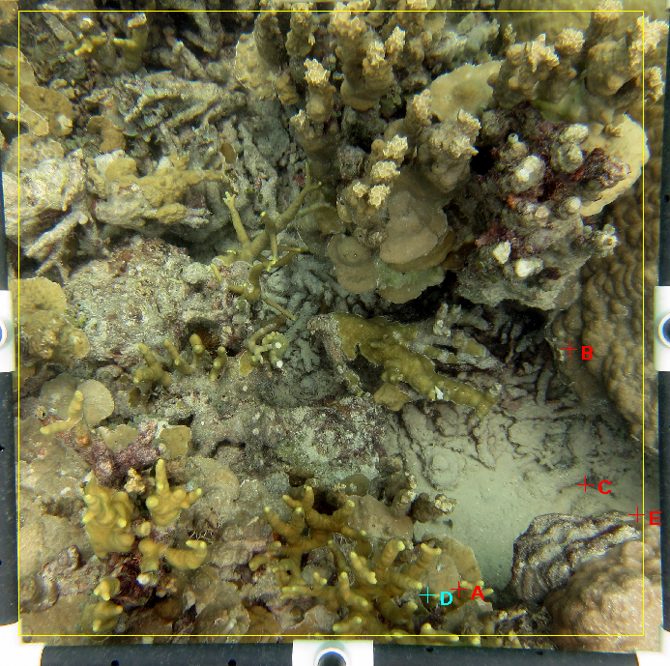
Porites Massive
Sand
Porites cylindrica
Sand
Porites cylindrica

Slide 26
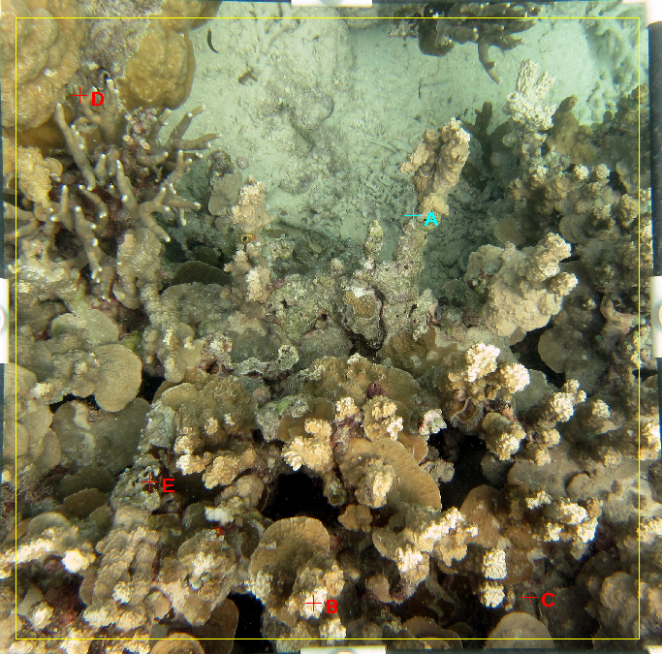
Porites cylindrica
CCA
CCA
Porites rus
CCA

Slide 27
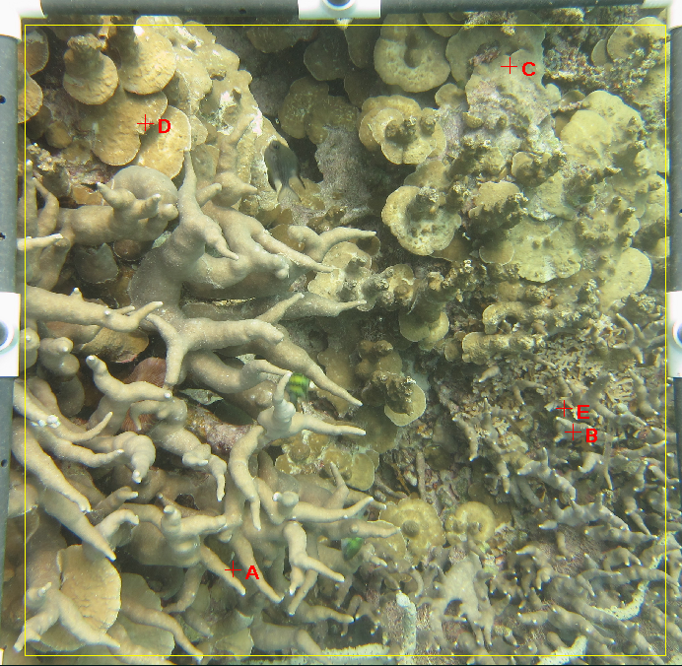
Porites rus
Porites rus
Porites cylindrica
Porites cylindrica
Porites cylindrica

Slide 28
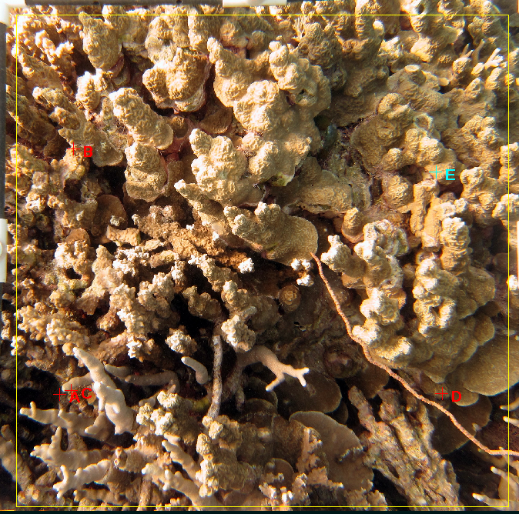
Porites rus
Porites rus
Porites cylindrica
Porites rus
FCA

Slide 29
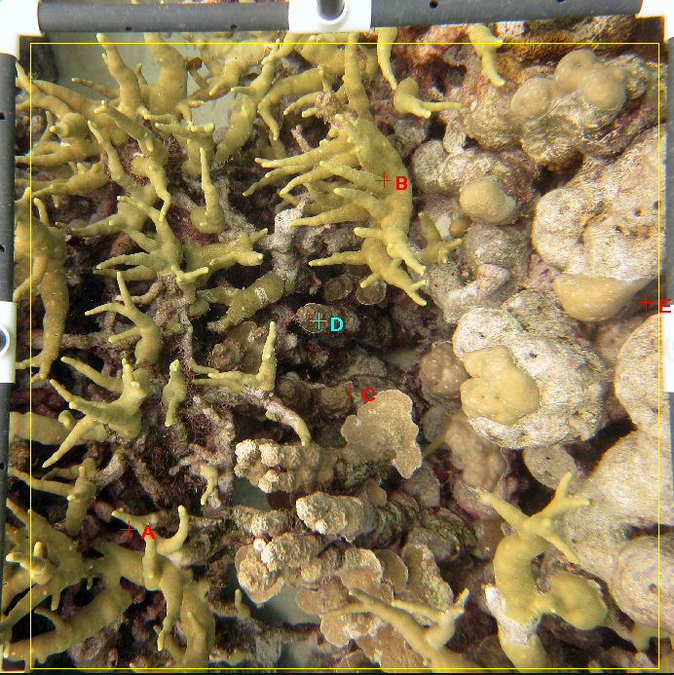
Porites cylindrica
Porites rus
CCA
CCA
FCA

Slide 30
Comparative pivot tables for Pohnpei

Slide 31
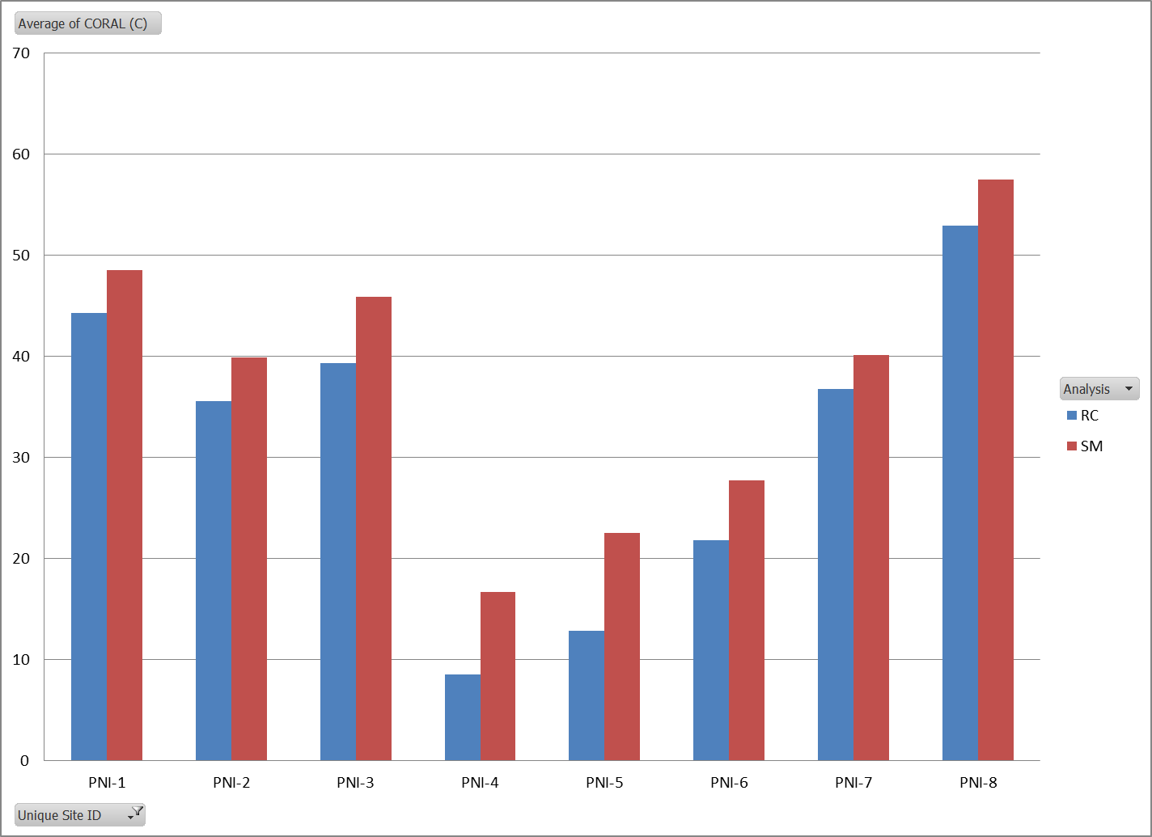

Slide 32
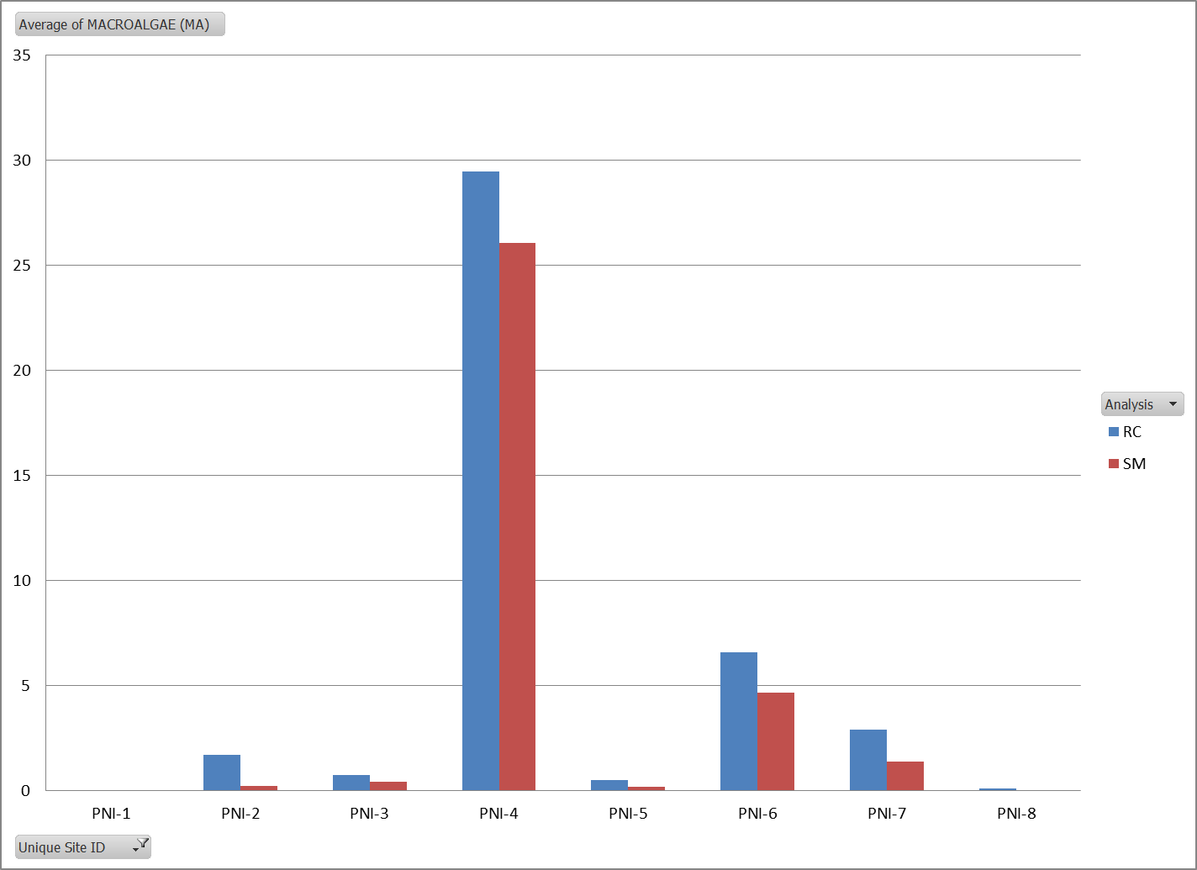

Slide 33
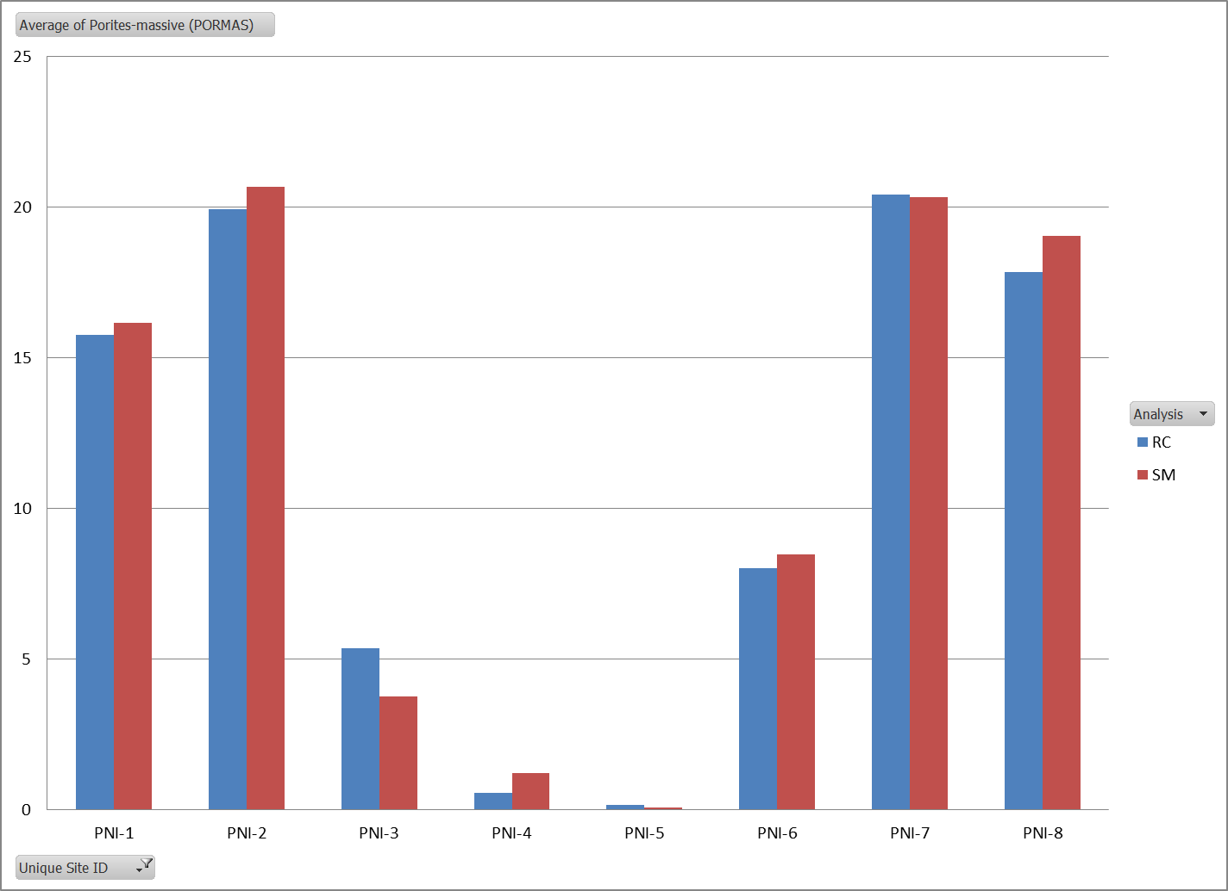

Slide 34
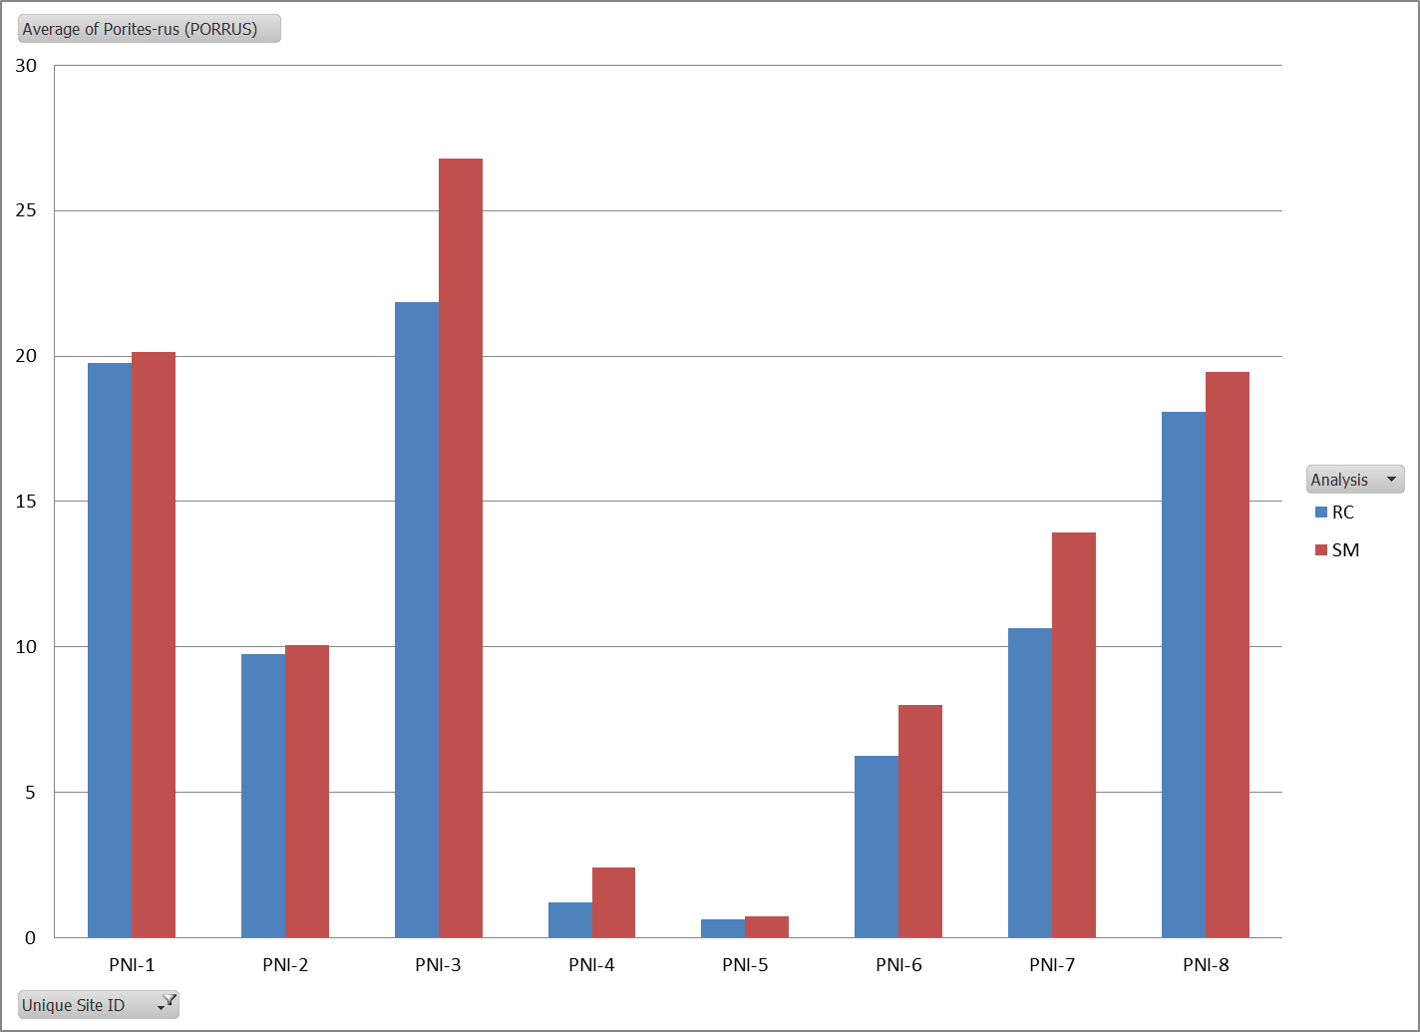

Slide 35
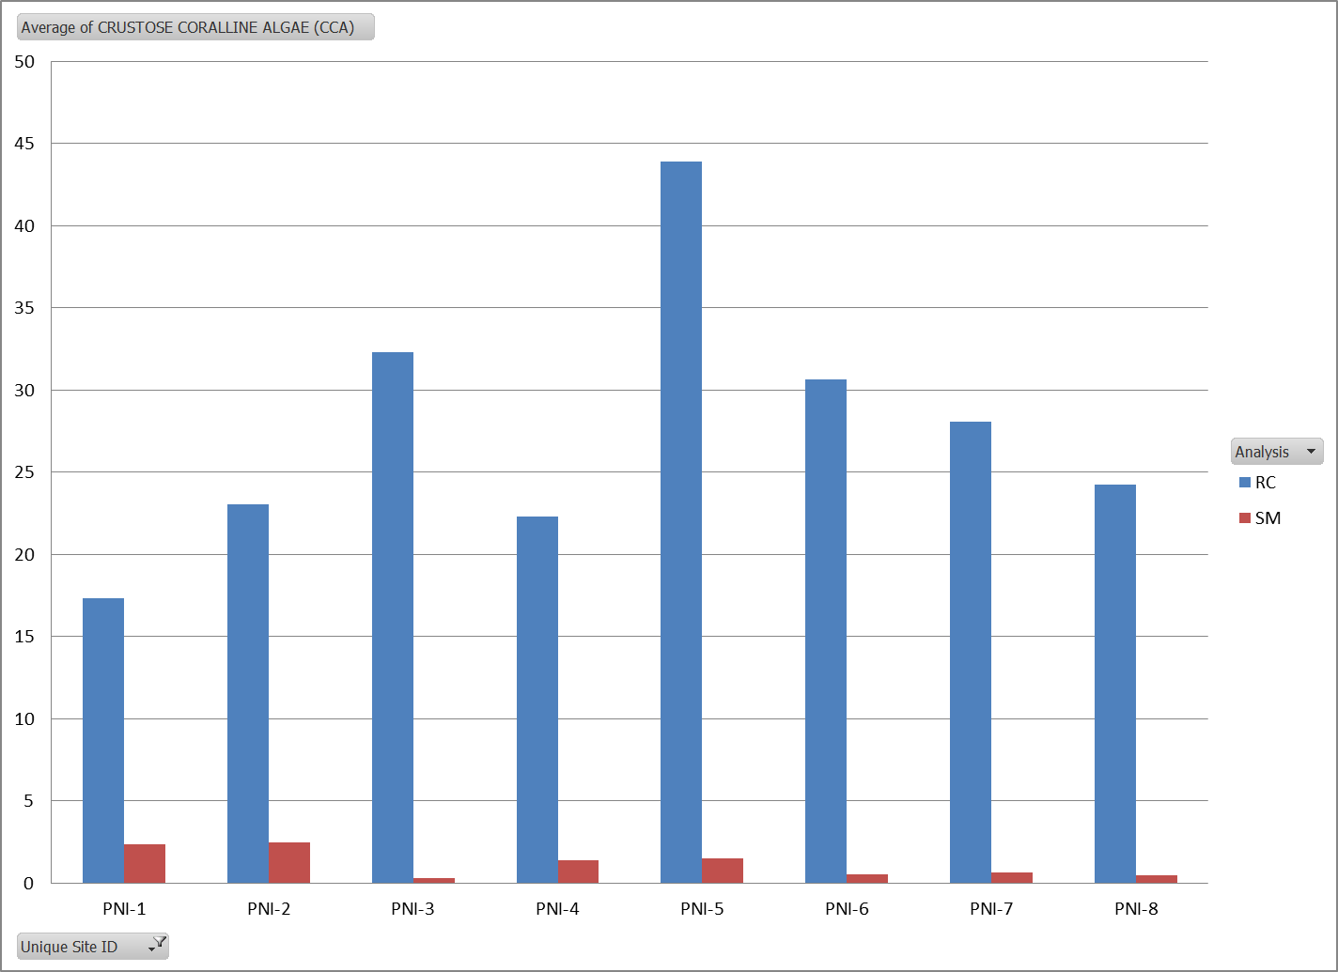

Slide 36
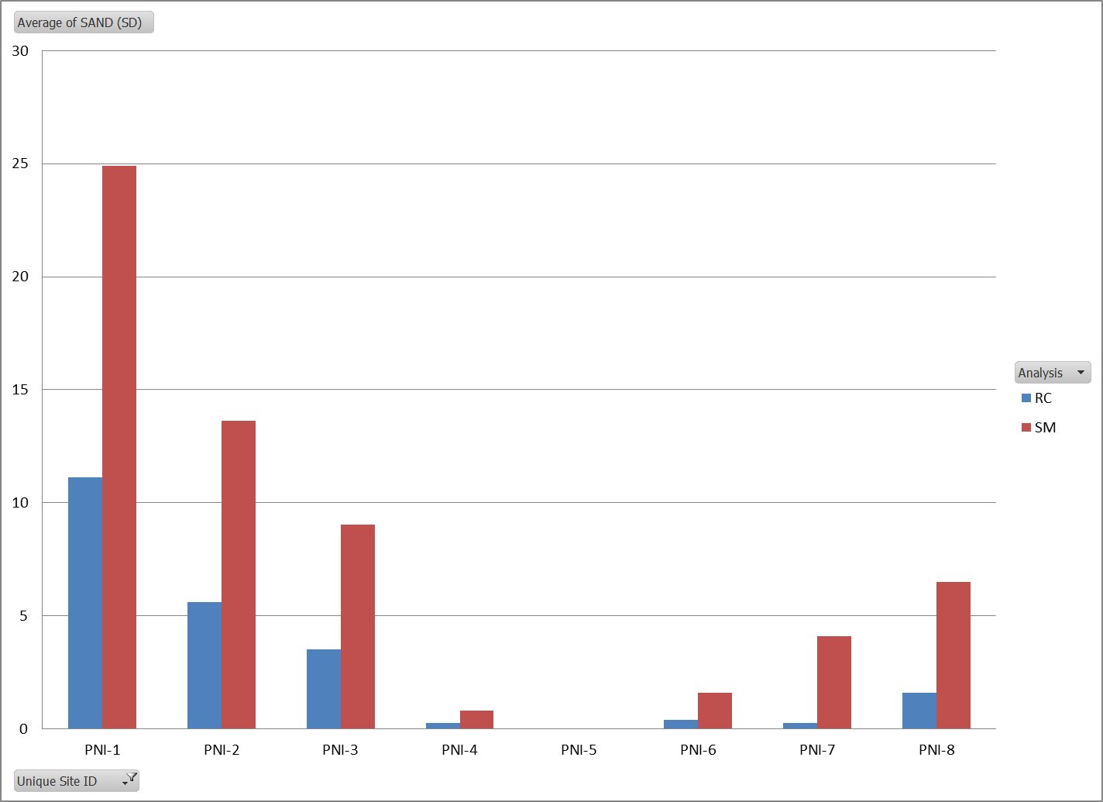

Slide 37
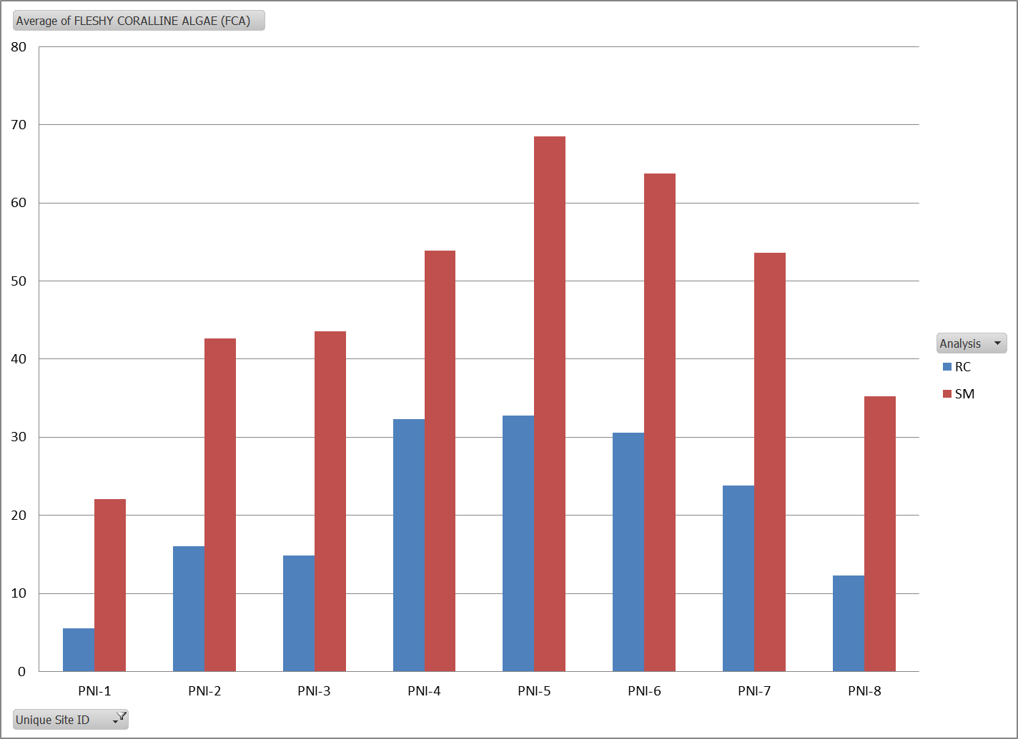

Slide 38
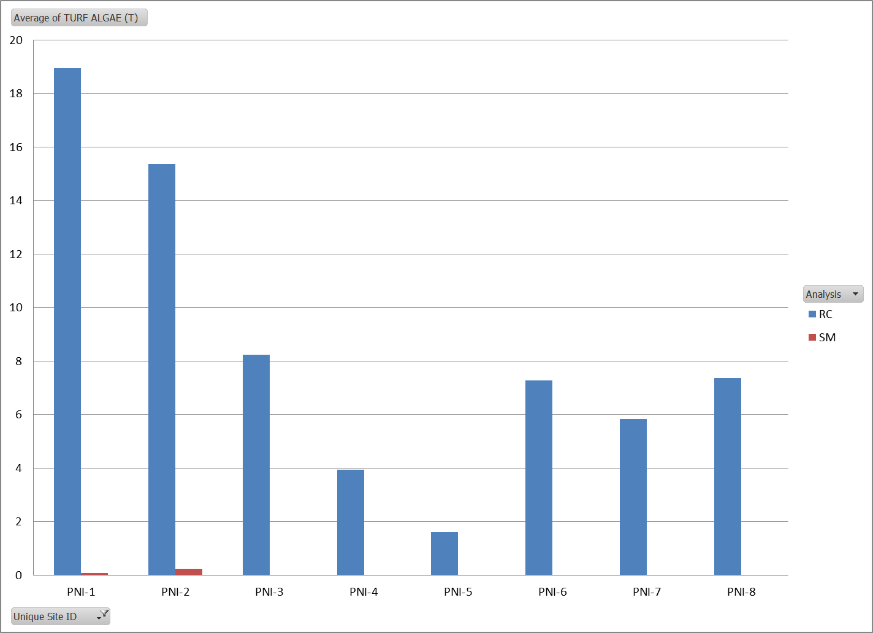

Slide 39
BSR – Benthic substrate ratio, or the ratio of calcifying substrates (i.e., good) to non-calcifying substrates (i.e., bad). This measure is one of the key indicators used to evaluate things like the MC.

