Slide 1
FSM REPORT

Slide 2
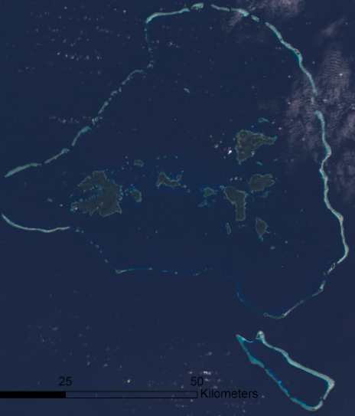
Chuuk Lagoon
* Chuuk Lagoon: one of largest lagoons in the world
Reef area 140 miles around
Enclosed Lagoon encompassing area 49 by 30 miles
Total area 820 square miles
Chuuk Population:
Roughly 50,000 people
Half of the total population of the entire FSM
Chuuk Lang Area:
49.2 square miles
Inter-island commuting by 40hp motor boat – use knowledge of tides & oceans on a daily basis

Slide 3
Tides:
Tides are mostly influenced by the gravitational pull of the sun and the moon on the oceans. While the sun is much larger than the moon, the moon is much closer to the earth, and thus has about twice the influence of the sun. The greatest effect on tides is when the sun, the moon and the earth are aligned or during new and full moon phases. Also, during the Northern Hemisphere winter, as the earth moves around the sun in its elliptical orbit, the sun and the earth are at their closest points. In general, the FSM experiences its highest annual ocean water levels as a result of these higher late fall-winter-early spring tides, which are referred to locally as “king tides”.
The tide tables for a location reflect the astronomical relationships as well as the historical characteristics of the tides at that location (if available; a minimum of 19 years of tide data is needed). As a result, the timing of occurrence of the high and low tides is usually pretty accurate. The absolute height of the tides, however, is not only determined by the above characteristics but also by atmospheric and ocean water characteristics that are NOT reflected in the tide tables. Ocean water characteristics are also related to atmospheric pressure, water temperature, and wind speed and direction. The greatest atmospheric influence on the tropical oceans is the El Nino-Southern Oscillation (ENSO).

Slide 4
The roles of tides and oceans in the FSM:
The story is related to tides in Micronesia (FSM) where at one point a “big wave” tidal wave swept through the islands in the Mortlocks and killed a number of people. People were not yet aware of what a tsunami is, but could only say “big waves”. As a result, some of the (Chuukese) Mortlockese people moved to Pohnpei. Now the number of Mortlockese live in Pohnpei has increased from a few hundredths to thousands.
The ocean means life to the Pacific islanders. For instance, the ocean is the main food source for the islanders. Fish is a daily meal which can be served anytime during the day. The ocean is also considered a ”refrigerator”. In the ancient time people catch fish for daily needs only; today fish is caught for commercial use, too. The ocean is a link between islands, a bridge that connects people.
Ocean is life; without the ocean life would be difficult for small island countries people to survive; tides is a normal cycle of ocean behavior dictated by the moon; during high tides ocean fish tend to wonder close to the shores; during low tides fish tend to go deeper into the ocean to find food.

Slide 5
Priorities, stakeholders, and services in the FSM:
Fishermen need to know when high and low tides are to occur; this way they would be able to know what kind of fishing methods will be used; for the boaters, they need to know tides so they can determine the best time to travel between islands.
Building ports by the source requires understanding of the tides; it is often recommended to build sea ports during low tides. While in Chuuk does not have a tide gauge yet, a tide gauge is needed to monitor ocean activities. Since most of the main islands in the FSM have tide gauges, one in Chuuk will help improved ocean monitoring in the region.
There are two existing projects on going in Chuuk that required tides and ocean information , for instance, JICA (Japan International Cooperation Agency) just recently committed to provide solar system projects in the islands. To do this, tides information is especially needed for the small and low islands. The road project on Weno island is on going which requires tides information since much of the road is built along the shores.

Slide 6
There is really no direct challenges relating to the on going projects because of tides. However as the road project is progressing, the design of the project factored in tides and storm surges impacts. The road is elevated to prevent water from run off.
A proposal to install a new tide gauge for Chuuk has been discussed on many occasions during PEAC conference. We’re still awaiting assurance from the local sponsor who will place the unit at his pier. Once this system is operational, the prediction of tides will become available and help assist climate outlook in the islands.
Weather and climate information are free to the public and can be directly downloaded from the noaa website at the data base in North Carolina; also the WSOs make copies available upon request.
The Agriculture and Transportation departments are two of the major stakeholders that request weather and climate information monthly. Recently we have established a joint effort with the Marine Resources Department to encourage more of ocean conservation measures to ensure ocean’s life and resources are protected and safe. In the following slide, we have presented a mission that is undertaken by the Marine Resources Department to enforce protection ocean’s resources.

Slide 7
The Mission of the Marine Resources Department in the state of Chuuk:
The Department of Marine Resources is mandated to enforce all maritime regulations within the state of Chuuk. Currently these laws include the law against dynamite fishing, trochus harvesting out of season, turtle harvesting out of season and harvest of undersized turtle species, regulations against foreign fishing vessels fishing within Chuuk States internal waters (all of these laws were made during the TT times and have been carried over with some amendments made to them...ie the dynamite fishing regulation) as well as some recent legislation passed just last year (2014) which include the ban on shark finning in Chuuk for commercial sale and the Chuuk State Marine Resource Conservation and Management Regulations which call for a total ban on sea cucumber harvest for commercial sale as well as seasonal closures and bans on other species . As part of this mandate, the department is required to conduct patrols of the lagoon as well as all commercial ports (markets, airport, shipment yards, etc.) to ensure that these regulations are adhered to. As such, staff members are also required to conduct outreach visits to communities and schools to make people aware of the regulations and their purposes.
DMR also conducts coral reef monitoring of select sites throughout the lagoon and some period assessments conducted in the outer islands. These surveys are meant to study the change over time of our reefs in regards to benthic/substrate composition, fish biomass & diversity and invertebrate population and diversity. This information is meant to assist resource managers at the community, municipal or state level to enact legislation, manage reefs/resources and raise awareness on the status of the marine habitats and the flora/fauna found within. Community consultations are also conducted with interested resource owners to formulate management plans for communities/resource owners that desire to protect and safeguard ocean’s resources.

Slide 8
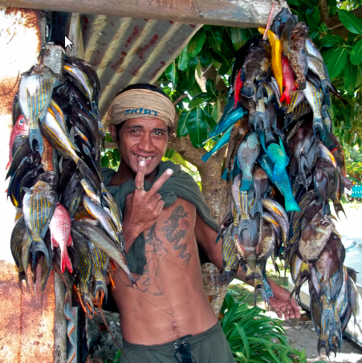
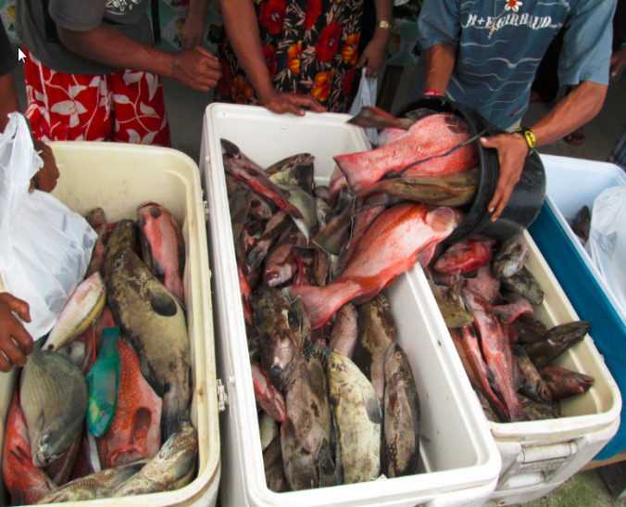
Tides & Oceans:
Great dependence on marine resources for commercial and subsistence livelihoods:
Ex: Parem Municipality – 80% identified themselves as fishermen/women
40% of respondents identified fishing as their main source of income
Chuuk exports – 250,000 – 450,000 lbs reef fish annually (2,300 lbs per day)
Knowledge of tides/oceans critical to fishing activities

Slide 9
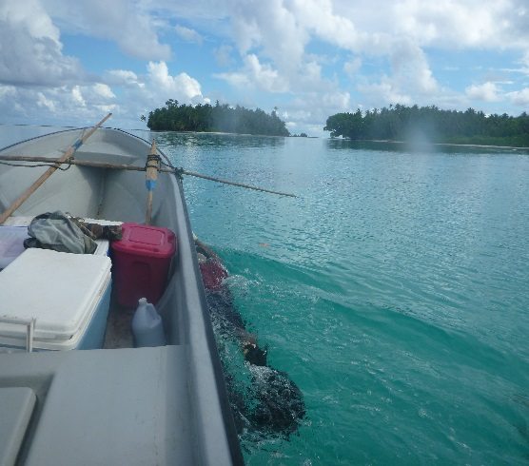
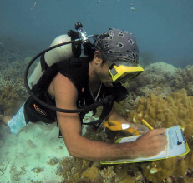
Priority Actions & Application:
Biological Monitoring – Sampling:
Purpose – Study trends occurring in our oceans & assess resiliency of our oceans to human induced or climate related impacts
Chuuk State Annual Coral Reef Monitoring Program:
Reef Health – Benthic substrate ratios
Resource biomass densities
Assess resilient vs. non resilient areas
Market Surveys:
Fisheries production
Reproductive rates
Spawning & aggregation tendencies

Slide 10
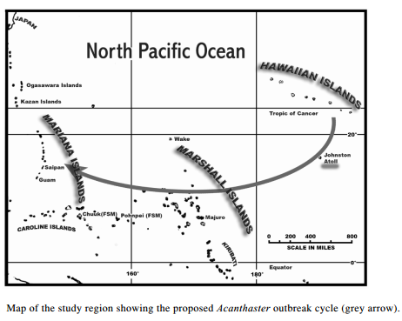
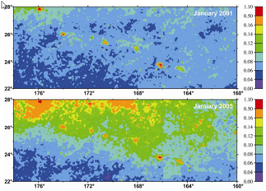
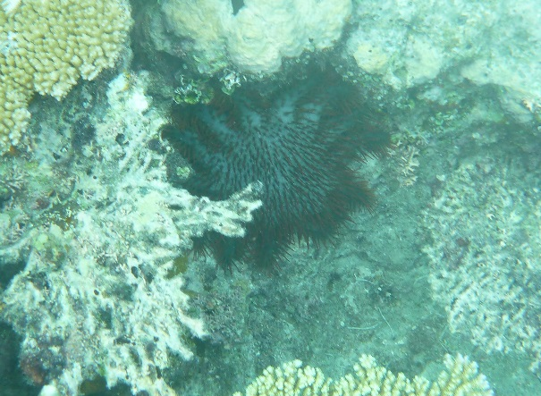
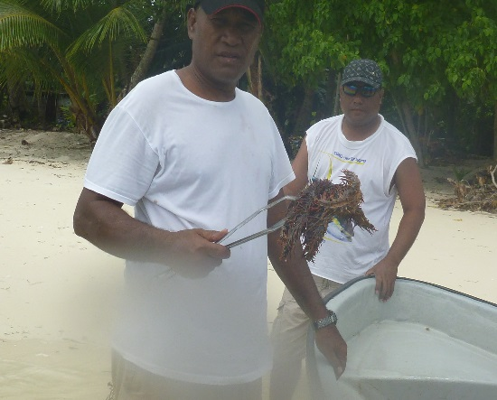
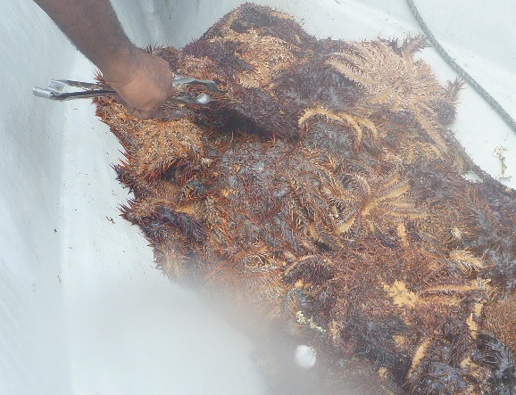
Ex: Proposed Outbreak Cycle of Acanthaster planci (Crown of Thorns)

Slide 11
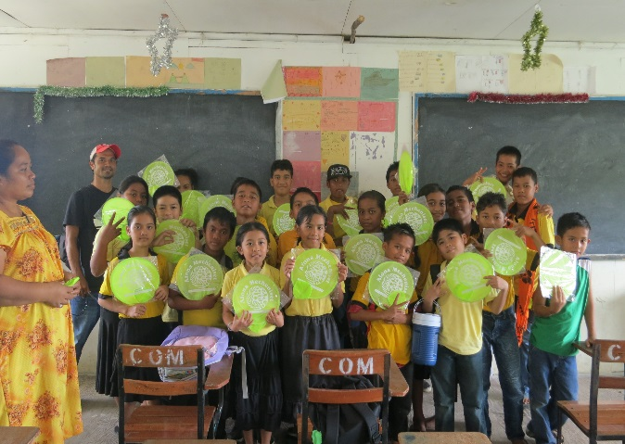
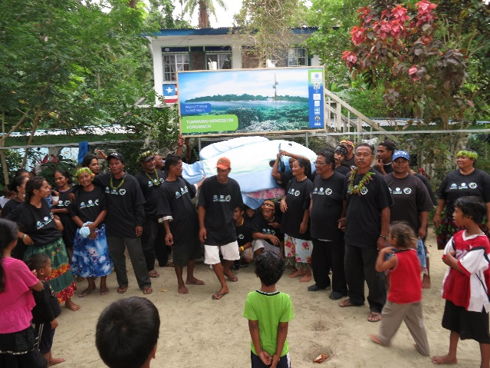
Community-Based Adaptive Management Initiatives:
Marine Protected Areas
Traditional Closures (Mechen)
Municipal Legislation
Ordinances
Capacity Building – enforcement, reporting.
Fish Aggregation Devices
to support communities who live in areas where weather/reefs aren’t favorable to fishing
Outreach & Awareness Activities
Ex: El-Nino – high risk of coral bleaching & sediment overload following heavy rains

Slide 12
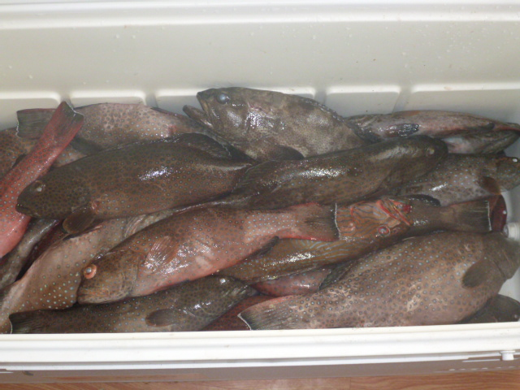
State & National Level:
Aligning State-level & community-based activities with National Biodiversity Strategic Action Plan
Partnering on national-level projects:
Global Environmental Facility – Protected Area Management
SPC-GIZ (Germany) – Community Ecosystem Management in response to climate induced impacts
State Legislations –
Seasonal closures
Bans on exports of certain species

Slide 13
Challenges:
Lack of Funding for staff, equipment & supplies
Relative Isolation – difficult to get services required to address critical climate induced impacts
Limited technical capacity on the ground
Political will – policies or legislation, etc.
Resource tenure-ship rights can sometimes slow down work
Lack of understanding of climatic impacts on Chuuk’s marine resources

Slide 14
House Swallowed by High Tide

Slide 15
Coastal Areas Impacted by Tides and Waves

Slide 16
Shoreline with Sea Level Rise Impact

Slide 17
Shallow water becomes deeper by increase in Sea level Rise

Slide 18
Sea Wall is built by the shoreline to protect residential areas

Slide 19
Mangrove Trees Bounded by High Tides

Slide 20
An island experiencing the impact of sea level rise

Slide 21
Coastline Erosion

Slide 22
Coastal Area is threatened by constant pounding of waves and high tide

Slide 23
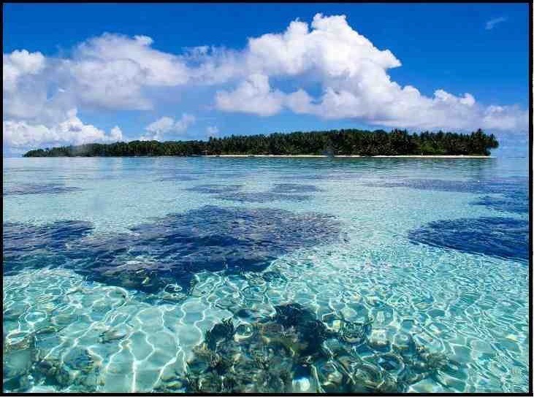
Kinisou Chapur

