Slide 1
Food Security in the Pacific
A Snapshot

Slide 2
Who am I
Secretariat of the Pacific Community, aka SPC
CROP agency, owned by RMI and all other Pacific Island Countries
8 technical Divisions covering water, geoscience, disaster management, energy, transport, health, education, human rights and social development, agriculture and forestry, and I suspect a few more…
I work for the Land Resources Division (Suva, Fiji based) that looks after the agriculture and forestry (and livestock) work area

Slide 3
Food Security – what is it?
?
Food security exists when all people, at all times, have physical, social and economic access to sufficient, safe and nutritious food to meet their dietary needs and food preferences for an active and healthy life. (World Food Summit, 1996)
Shorter Definition
Food security refers to access by all people at all times to sufficient, safe and nutritious food for a healthy and active life.
Notes:
Read

Slide 4
FOOD SECURITY DIMENSIONS
FOOD SECURITY
Food Availability
  Refers to “Sufficient” amount of food that is present in a country/area through local food production and imports or food aid
Food Access
Refers to “physical, social and economic access” to acquire adequate amount of food consistently through production, purchases, barter, borrowings
Food Utilisation
Refers to “safe and nutritious food which meets dietary needs for an active and healthy life”
Food Stability
Refers to “at all times” in the definition and applies to all 3 dimensions
Notes:
Read

Slide 5
Determinants of Food Security
Nutritional
Value and
Distribution
Social
Safety Net
System
Food aid
transfer
Income aid
transfer
Aid transfer-
Based entitlement
Food
Security
Food
Availability
Food
Accessibility
Food
Utilization
Nutritional
Adequacy
Resources
Production
Income
Market-
Based
entitlement
Processing
and
Consumption
distribution
Market
Economy
System
Food imports
We know CC and CV cuts across all the pillars and within the sub-systems,
but how, and by how much, we don’t know just yet…
Notes:
The determinants of FS are basic but the building blocks and supporting elements and mechanisms required are complex and interrelated. Here we can see how in today’s modern society, food security is also a function of the social safety net system as well as the market economy.

Slide 6
Food Availability – National Level
Country | Kcalorie/per/day | % Import
Fiji | 3663 | 51
Kiribati | 3534 | 63.7
Solomon Islands | 2422 | 55.8
Vanuatu | 2757 | 49.2
Cook Islands | 3185 | 83.4
Samoa | 2886 | >60%
Marshall Islands | 2950 | 89
Country District/ villages | % Energy Local | % Protein Local
Korobebe | 48.9.0 | 33.2
Nabuotini | 45.6 | 38
Kolonga | 60 | 32.5
Tefisi | 54.9 | 55.8
Notes:
As a snapshot, let’s have a look at food availability in some of the countries, including RMI here. As you can see, the level of imports and the consumed calories on average can tell interesting stories and could act as indicators as to the situation of food security at the national and local levels.

Slide 7
FS Issues in PIs
Food Production
Except SI, Tonga & Kiribati, average agriculture annual growth rate has declined since 1990s
Similar trend for share of agriculture to total GDP
Share of agriculture to total GDP for PNG and SI are mainly due to increased export of coffee, palm oil & coconut oil
Notes:
Here, we’re seeing today that across the region for the most part, local food production is declining, as is reflected in the contribution of the sector to the total GDP. It is interesting to note that those two countries that show an increasing share are due to the development of export markets and the local supply of coffee, palm oil, and coconut oil and copra products.

Slide 8
FS Issues cont’d
Food Production
Overall food production per capita is declining
Overall livestock production is increasing throughout the region
Notes:
From a food production perspective, across the region, local food production is decreasing.
Although the livestock numbers might be increasing, there are costs to this decrease and does not directly indicate an increase in food security. That is, livestock lands increasing means giving up the use of land for other agricultural uses or conservation of land for environmental purposes.

Slide 9
Fish Availability/Consumption
Most fish consumption comes from coastal fisheries
Most countries (especially rural) above requirements (35kg/year)
Even well managed coastal fisheries will not provide the future fish needs
Notes:
We stole this graph from one of our fisheries colleagues. At 35kg/yr minimum requirements, rural areas are consuming fish in high numbers as their main source of protein. As this source is ‘free’ even the best managed coastal fisheries will have difficulty in providing future demand for fish.

Slide 10
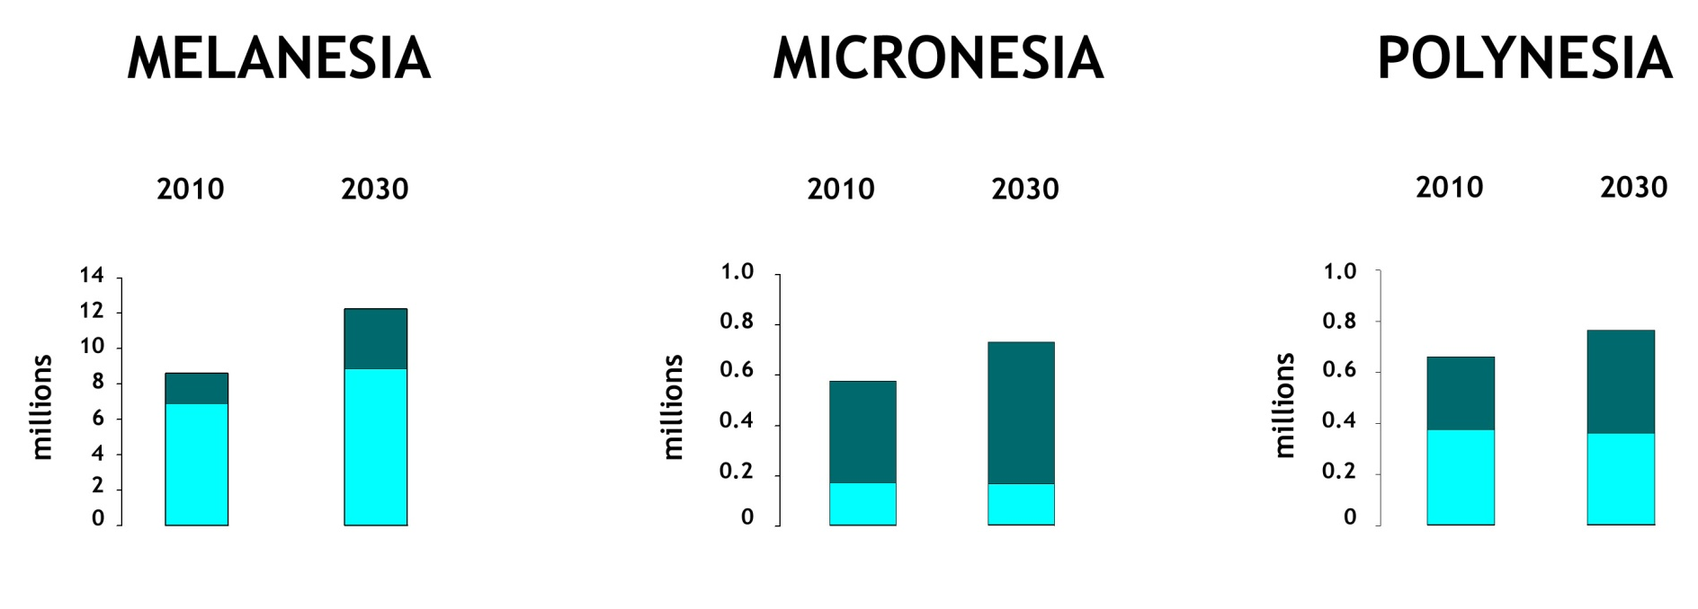
Food Availability Issues in PIs
Population Growth
Region’s population will double in 2050
Extra 115 000 tonnes of fish per year must be provided across region (CC and Pacific Fisheries – SPC)
Notes:
And the reason why is because the demand side is slated to increase across the Pacific region, noting the increase in overall populations and the still significant numbers of rural dwellers.

Slide 11
FBS
Country | Kcal/person/day
 | 1990 | % Imported | 2005 | % Imported
Fiji | 2592 | 38 | 3001 | 51
SI | 1984 | 27 | 2433 | 56
Vanuatu | 2498 | 34 | 2575 | 49
Samoa | 2614 | 33 | 2769 | 65
Tonga | 2918 | 39 | 2992 | 45
Kiribati | 2589 | 29 | 2854 | 64
RMI | 2819 | 67 | 2950 | 89

Slide 12
Arno sample HIES FBS
Table 5. Energy Sources
 | Coconut | Breadfruit | Pandanus | Banana | Total Local | Rice | Flour | Ramen | Total Import | Total/day/person | % Import
g | 91 | 85 | 25 | 41 | 241 | 541 | 218 | 34 | 793 | 1034 | 91%
kcal | 167 | 86 | 14 | 24 | 292 | 1949 | 794 | 124 | 2867 | 3158
Table 6. Protein Sources
 | Pork | Chicken | Tuna | Reef fish | Total Local | Can fish | Can meat | Chicken | Total import | Tot/person/day | % Import
g | 1 | 8 | 3 | 39 | 50 | 61 | 28 | 1 | 89 | 140 | 81%
kcal | 4 | 9 | 2 | 25 | 41 | 112 | 64 | 1 | 178 | 218

Slide 13
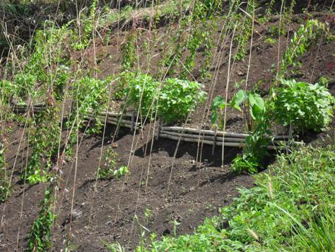

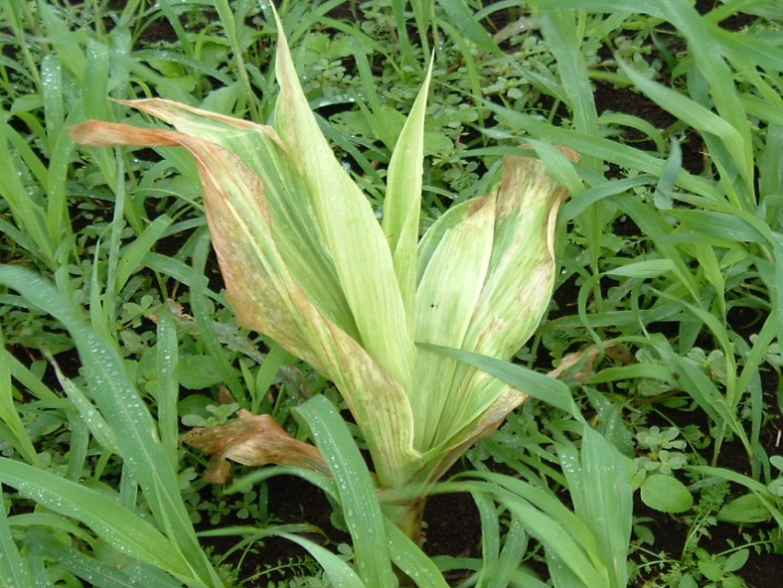
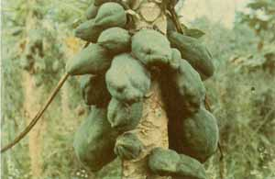
Soil Health and productivity

Slide 14
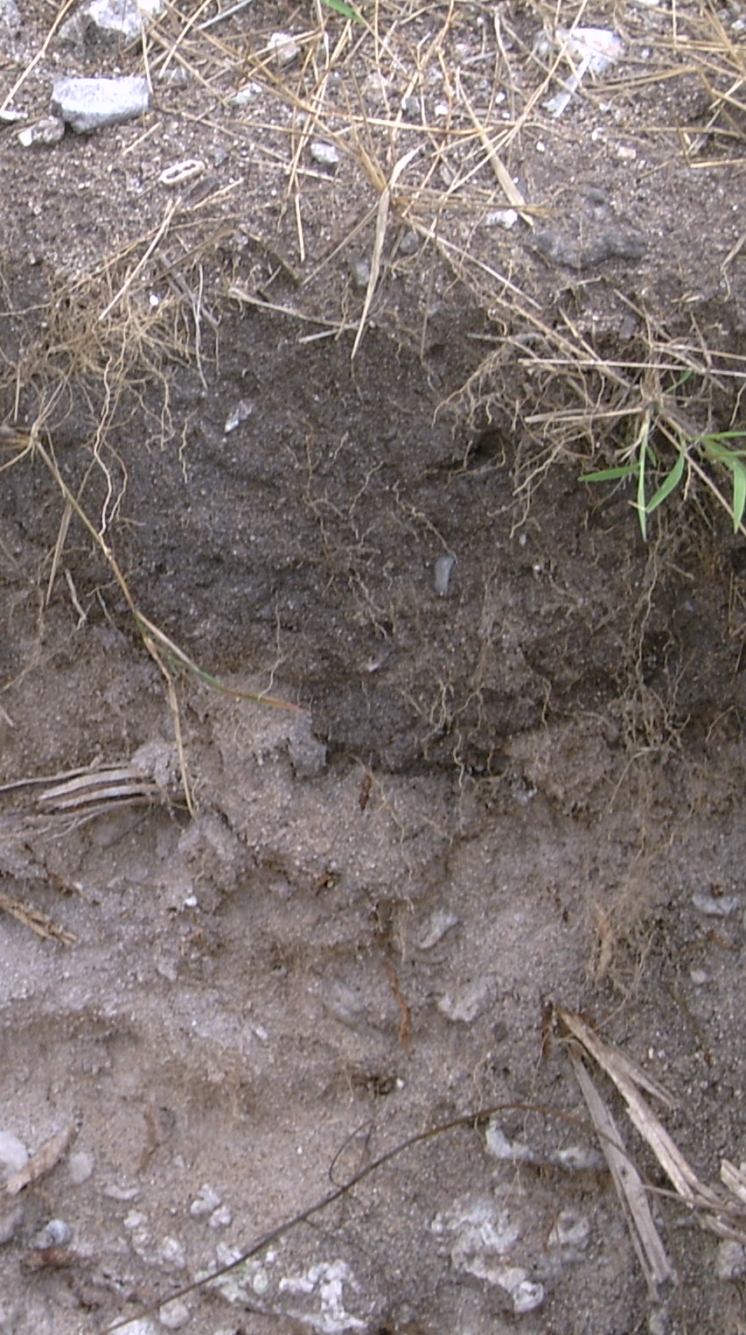
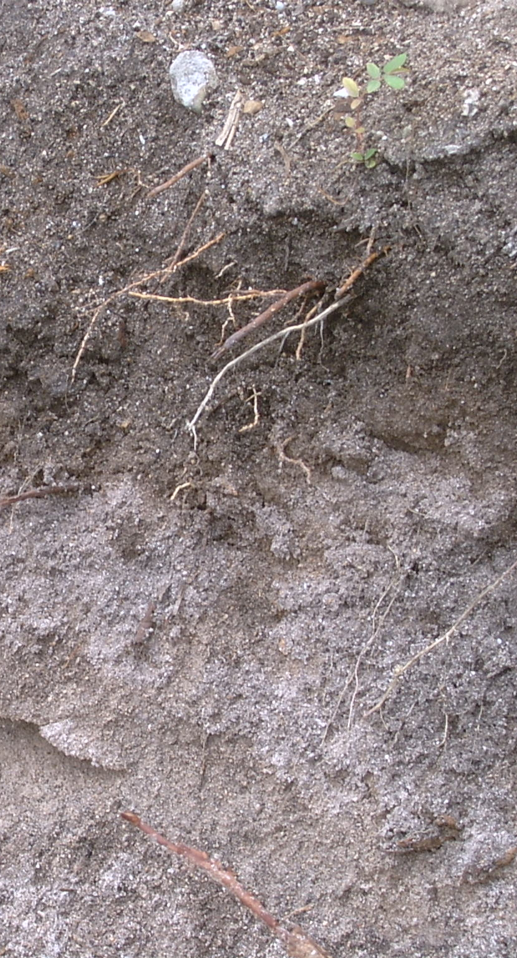
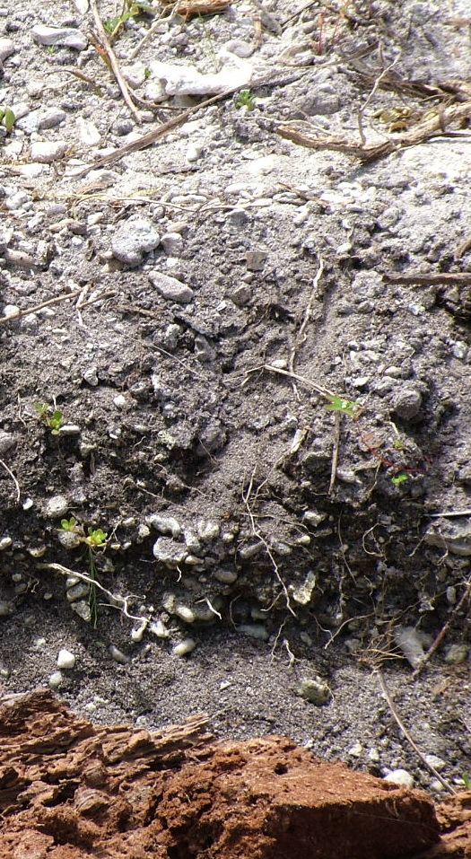
Poor native soil fertility (atolls)

Slide 15
Food Access Issues
Land Access
Village | % HH have land | Average size (acre) | Land Quality | % Grow own food
Divers Bay | 100 | 6.42 | Good (23%) Average (77%) | 100
Sepa | 96 | 2.89 | Good (63%) Average (30%) Poor (7%) | 89.2
Loimuni | 92 | 1.32 | Good (33%) Average (40%) Poor (17%) | 70.37

Slide 16
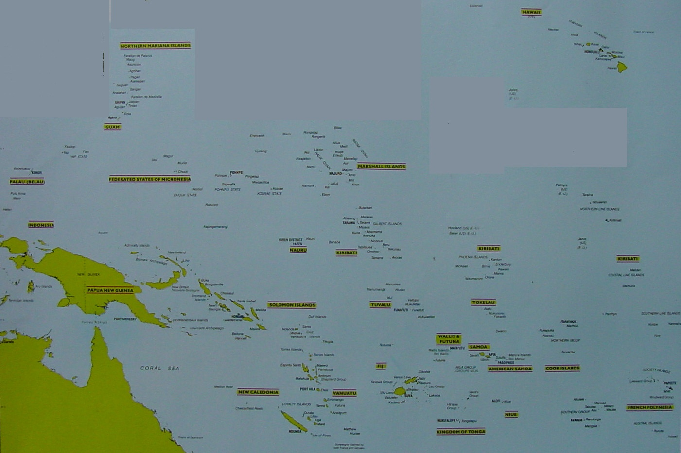
Pest and Disease Distribution
1
No. of economically important species
Bactrocera ochrosiae
Bactrocera cucurbitae
2
1/2
Total no. of fruit flies in a country
1/2
Bactrocera ochrosiae
Bactrocera cucurbitae
1/1
1/1
Bactrocera fraunfeldi
Bactrocera fraunfeldi
1/1
Bactrocera near passiflorae
Bactrocera xanthodes
Bactrocera kirki
Bactrocera distincta
Bactrocera obscura
Bactrocera aenigmatica
Bactrocera samoae
Bactrocera near paraxanthodes
2/7
1/1
4/5
Bactrocera fraunfeldi
Bactrocera cucurbitae
Bactrocera dorsalis
Bactrocera xanthodes
4/4
Bactrocera near passiflorae
Bactrocera fraunfeldi
Bactrocera umbrosa
Bactrocera phillipinensis
Bactrocera occipitalis
Bactrocera calophyli
2/2
Bactrocera distincta
Bactrocera kirki
Bactrocera xanthodes
Bactrocera obscura
Bactrocera passiflorae
Bactrocera cucurbitae
Bactrocera fraunfeldi
18/188
Bactrocera melanotus
Bactrocera xanthodes
4/48
4/7
3/5
2/3
Bactrocera atramentata
Bactrocera atrosetosa
Bactrocera bryoniae
Bactrocera cucurbitae
Bactrocera curvifera
Bactrocera decipiens
Bactrocera fraunfeldi
Bactrocera lineata
Bactrocera moluccensis
Bactrocera musae
Bactrocera neohumeralis
Bactrocera obliqua
Bactrocera papayae
Bactrocera strigifinis
Bactrocera trivialis
Bactrocera umbrosa
Dacus axanus
Dacus solomonensis
Bactrocera fraunfeldi
Bactrocera umbrosa
Bactrocera cucurbitae
Dacus solomonensis
Bactrocera xanthodes
Bactrocera distincta
Bactrocera passiflorae
Bactrocera kirki
Bactrocera obscura
Bactrocera gnetum
Bactrocera near passiflorae
Bactrocera xanthodes
Bactrocera kirki
Bactrocera tryoni
Bactrocera dorsalis
Bactrocera luteola
Bactrocera atra
Bactrocera perfusca
Bactrocera distincta
Bactrocera kirki
Bactrocera xanthodes
Bactrocera obscura
Bactrocera tryoni
Bactrocera psidii
Bactrocera curvipennis
Bactrocera umbrosa
Bactrocera mucronis
Bactrocera caledoniensis
Bactrocera aneuvittata
Bactrocera fulvifacies
Bactrocera perpusilla
Bactrocera ebenea
Bactrocera paraxanthodes
Bactrocera grandistylus
4/12
4/7
3/4
Bactrocera facialis
Bactrocera xanthodes
Bactrocera kirki
Bactrocera distincta
Bactrocera passiflorae
Bactrocera obscura
5/6
Bactrocera trilineola
Bactrocera umbrosa
Bactrocera quadrisetosa
Bactrocera passiflorae
Bactrocera kirki
Bactrocera xanthodes
Bactrocera obscura
3/12
3/4

Slide 17
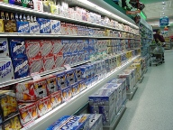
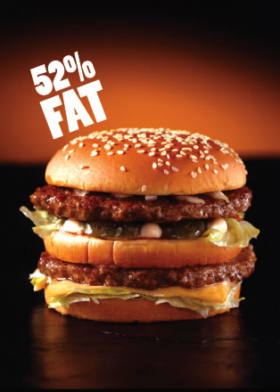
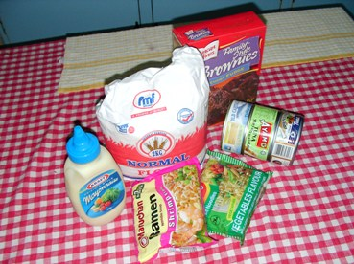
FS Issues
No longer grow own food
Increasing control of supermarkets on diet
High prices forcing to buy cheap, poor quality food import
Unemployment = low labor productivity = Loss of traditional knowledge

Slide 18

Food Access Issues

Slide 19
Food Access Issues
Poverty

Slide 20
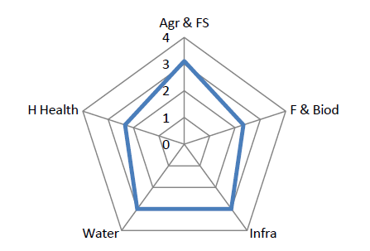
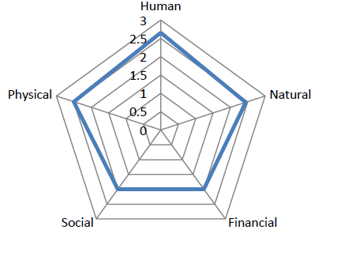
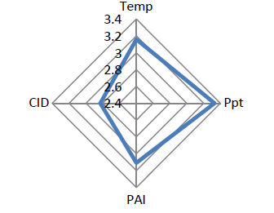
Food Stability

Slide 21

Changing times
1980s
2015

Slide 22

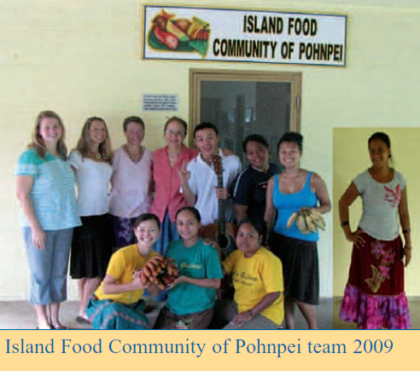
Leadership and cooperation
Leaders, PHMM, MOAFs, FEMM continue to prioritize food security works in the region
Prior to and after Vanuatu Regional Food Summit – national food summits (RMI FS WG status?)
Food and nutritional security has been incorporated to some national development and sectoral plans
Regional and national integrated approach set up – SPC/WHO/FAO
National food security frameworks developed
Notes:
Theme 1 recognizes that government working alone cannot achieve
food security.
This theme outlines a leadership
structure and ways in which sectors can cooperate to build strong national
and regional partnerships to face current and future challenges to our food
system.

Slide 23
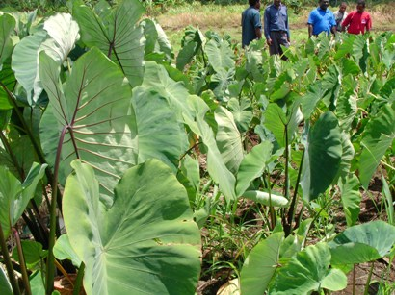
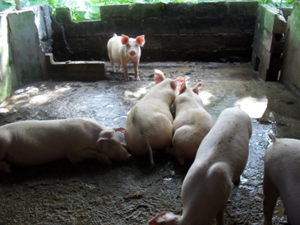
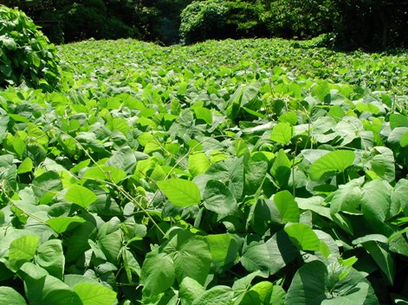
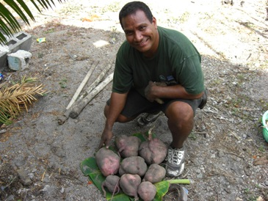
Enhanced and sustainable production, processing, marketing, trading and use of safe and nutritious local food
Support for food production
- Go Local
Promote local agricultural production
Building resilience of systems
* CePaCT and Centre (Tarawa)
* Soil health and ICM

Slide 24
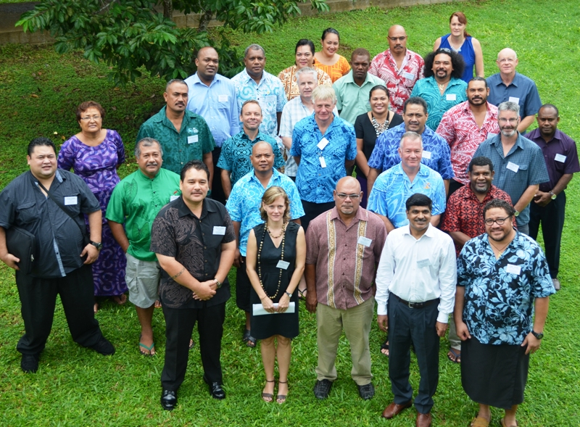
Agriculture Food Security
Expert Roundtable
Apia Feb 2015

Slide 25
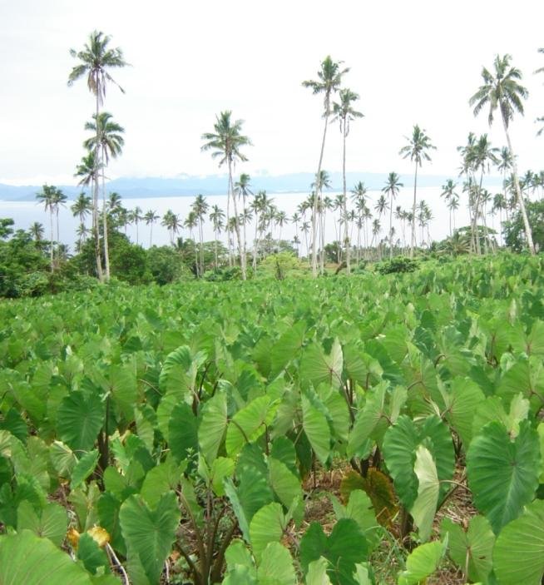
context
Agriculture in Pacific livelihood dependent
  Approx. 40% dependent globally, Pacific 70-80% directly dependent
High need is continuous for technical capacity, training, investment in sector at community to large scale commercial farming
Growing small to large commercial agriculture sector development
What about base food security concerns?
What about nutrition? Downstream health impacts e.g. NCDs? PICTs are top 5 in the world on obesity!!!

Slide 26
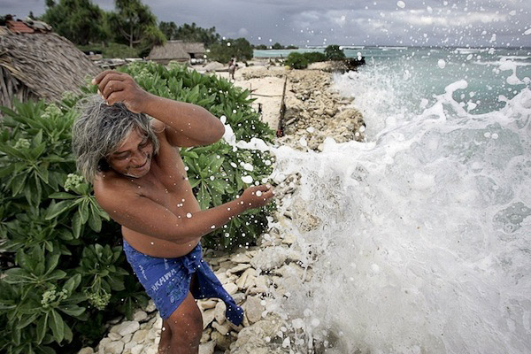
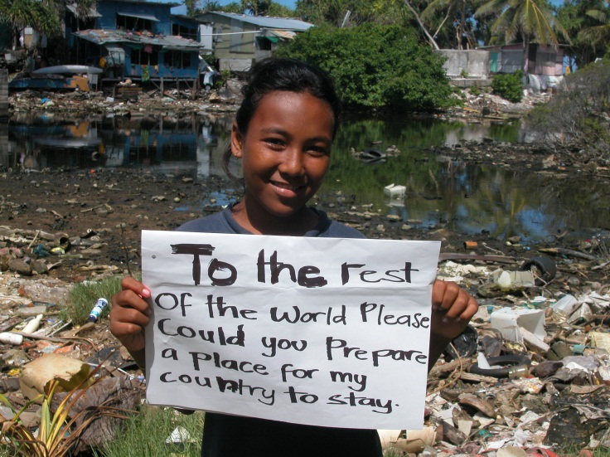
CC and CV
Historically, impacts from extreme weather and climate events have caused food shortages from interrupted agricultural production at all levels
Multiple stressors involved:
  Global food market systems have a role, added complexity in food security
  Population movements
  Imported foods
  Land use/tenure etc.
Traditional knowledge systems still in play

Slide 27
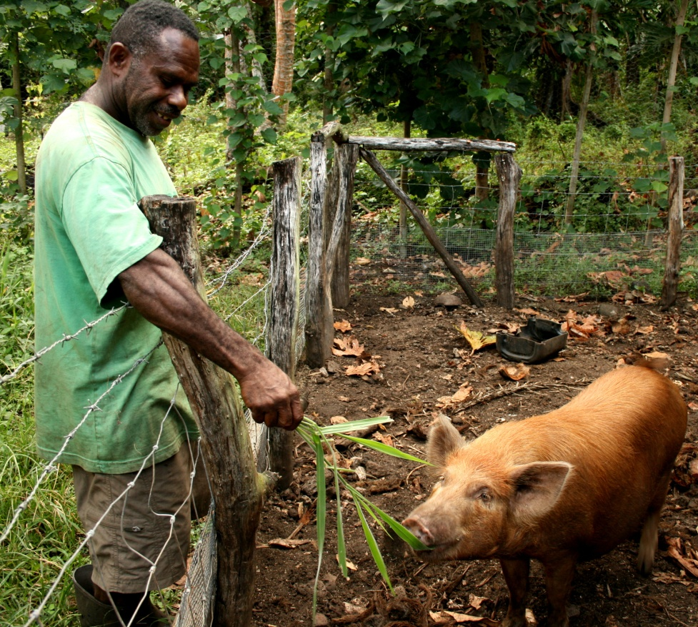
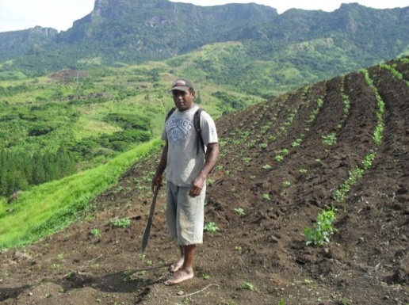
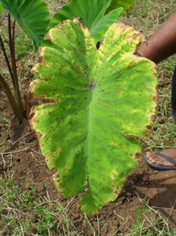
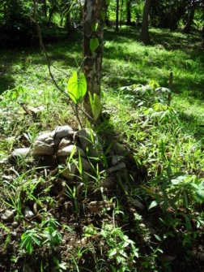
Agriculture
Institutional strengths/weaknesses
  MAFs of the Pacific, capacities/capabilities, planning/policy, information management (corporate/subject matter), research/extension services etc.
  Ability to react and respond to natural hazards and disaster events
  Ability to plan around natural hazards and disaster events
End user characterization
  Who/What/Where/Why/When/How

Slide 28
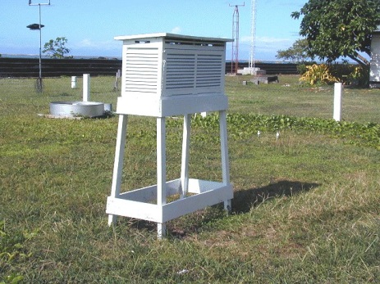
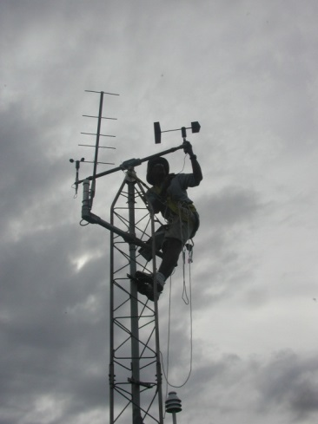
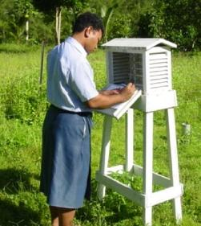
Pacific Met Services
Climate services capacity are different from country to country, but base services are available (e.g. seasonal forecasts, historical climate data and analysis services)
Have moved into application development, interests in developing impact forecasting, hence need to engage sectors
Regional organization, coordination well developed :-)
Some have ongoing partnerships with MAF counterparts via projects, research interests
Technical capacity is high (e.g. running application models for climate services like fire warning, drought monitoring) and services available – however need levelled up counterparts in Ag to raise efficiency in services

Slide 29
Combined Services?
Observation networks need partnering for expansion
Need technical training from Ag counterparts (and vice versa i.e. meteorologists need to be agronomists and vice versa)
Resources available to develop focused products and services are limited – how can we raise opportunities?
Communication strategies in development
Crop modelling capacity exists and needs expanding for active application (e.g. in research), data available from met what about Ag side?

Slide 30
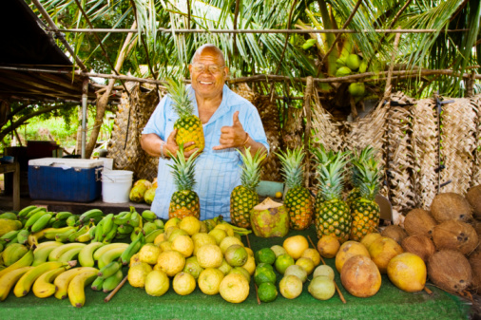
Vision
Strong food security base in the Pacific (and in support of commercial Ag)
  Community food production systems and base food security is highly vulnerable to CV and CC
Improved and value added services delivered effectively to end users
  How can climate services add value to existing agricultural services?
Sector equipped and using new tools, information, for effective planning, development of improved policies etc.
  IKM solutions, ISPs, commercial sector development

Slide 31
Expert Roundtable
Where to from Here?

Slide 32
Roundtable
First formal exchange with weather/climate counterparts
Open information sharing and learning mode
Open and frank discussions
Common view on improving services to agriculture end users through value adding agricultural advisory services with climate services

Slide 33


Slide 34
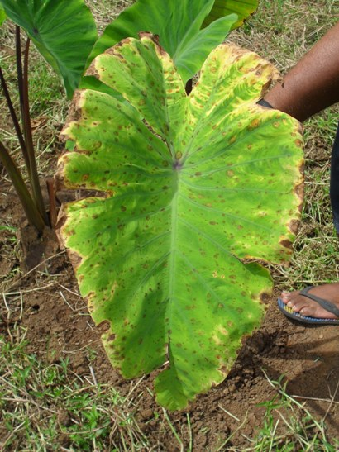
Ministry Institutional Capacity, two way communication, vulnerability assessments, data access and sharing, information knowledge management, community work plans, preparation and preparedness levels, access to timely warnings and advisories
Farming systems, PAR, Acceptable choices of risk, community development plans, two way communication, traditional knowledge, preparation and preparedness levels
Dynamic soil maps, water availability maps, understanding nature of risks, access to timely warnings and advisories, demand-side driven, crop diversification, PAR, data access and sharing, traditional knowledge, sunshine and rainfall data, observing network stations, formatting standards, research data and info sharing

Slide 35
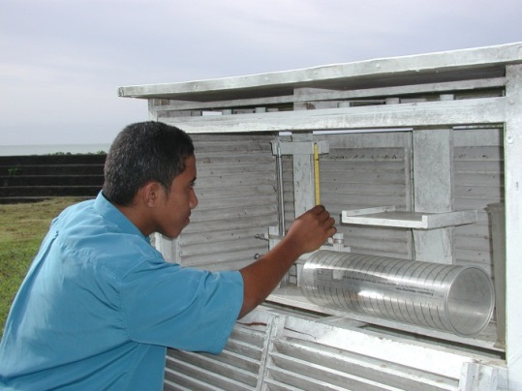
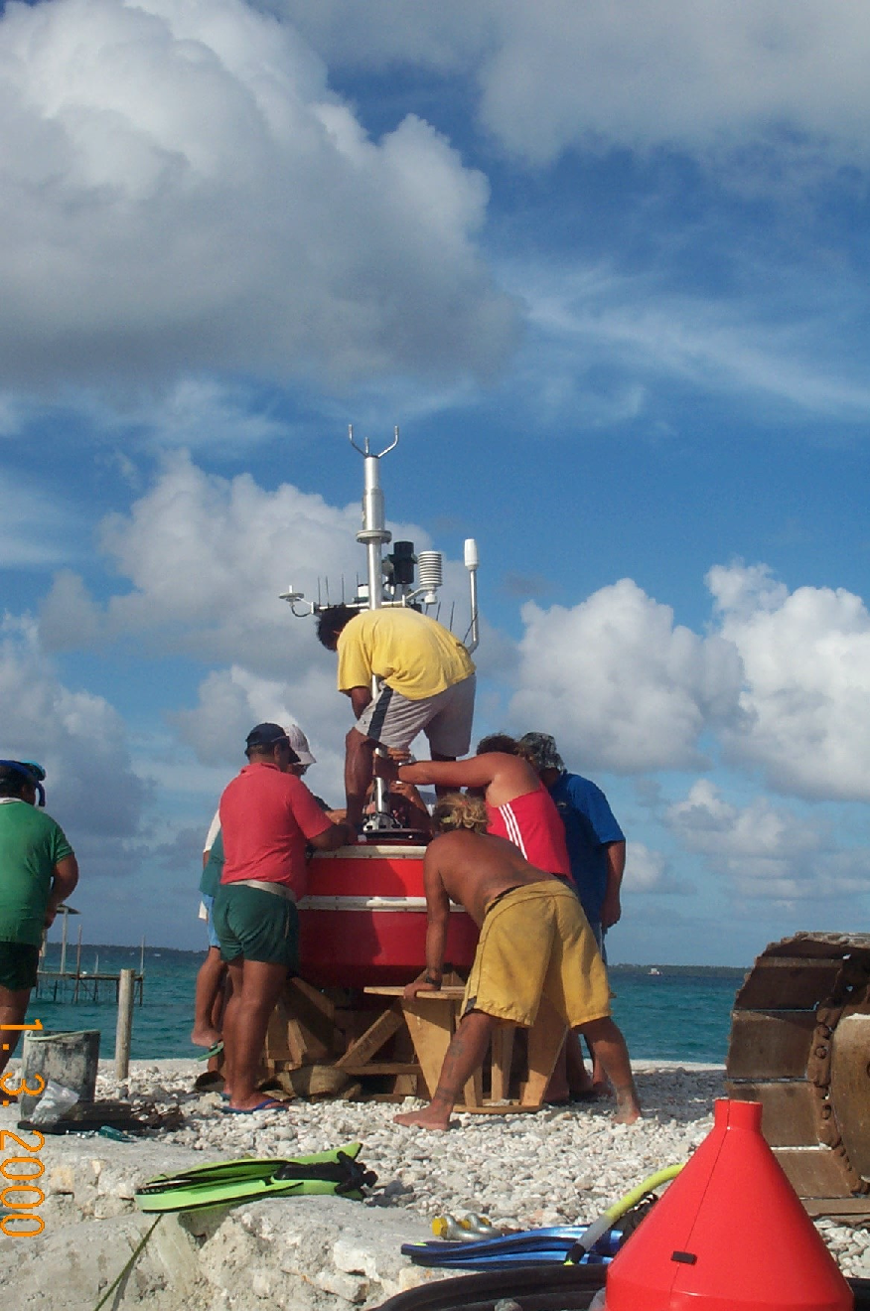
Agromet Advisory Committee, Joint Climate Forecasting, MOUs, LOAs, Policy and Planning Consultation, AgroMet Summit, data and information policies, research, resources limit development
Traditional knowledge, two way communications, observation networks, seasonal/harvest calendars, realistic expectations, farmer field schools
Agriculture data (crops, yields, soils etc.), Climate databases, resources limit development, extreme events and impact forecasting, forecasting is not an exact science, realistic expectations, communications strategies

Slide 36
National level
Regional level
Proof of concept

Slide 37
national
Agriculture and Met meeting each other!
Capturing and sharing of best practices (national experiences, lessons learnt, peer to peer training, national policy/planning/coordination guidelines and requirements)
Creating/formalizing new partnerships and workspaces
E.g. Tonga/Vanuatu/Samoa guiding principles and manual for MAF/MET formal engagement, sharing info/data principles, user engagement, shared communication plans, shared research priorities etc.

Slide 38
regional
Supporting actions by regional agencies in support of national level efforts
Resource mobilization, identifying new opportunities, leveraging existing activities in-country, e.g. capacity building programmes, facilitation of peer to peer exchanges/training, policy/planning/coordination guidelines and requirements
Terming this piece in partner/donor programmes
Example: Existing SPC/FAO/SPREP/NIWA programmes in demo countries, existing funding opportunities, engaging WMO in CAgM, RAV CS-Ag, SPC/SPREP/FAO under FSPF, SPREP under PICS Panel and PMC/PIMS

Slide 39
proof of concept
Demonstration/learning around an ‘event’ for joint collaboration.
Example: Drought seems the most highly rated risk hazard to agriculture services. Case study approach and experiences developed in countries, support from ext. agencies

Slide 40
so, moving forward
Workshop background, shared interest and concern for agricultural end user under weather and climate extremes pressure
Emerging work space of need identified, and requiring of some regional multi-agency ecosystem of support to national efforts
Identified some ‘low hanging fruit’ of achievable on ground activities (e.g. training), and opportunities (March 31 concept note to GFCS), key/priority areas for action

Slide 41
Summary and affirmations
There exists a need to support agricultural end users. Driving needs are many (productivity, total loss risks, commercial/subsistence livelihoods/food security). MAF and MET share the concern and each has supporting assets and capacities.
There is much to share with results in much enhanced support to the end user
There exists opportunities and interests at regional level to support the ongoing national effort on the ground

Slide 42
Moving Forward
Where To From Here?
Agencies (regional and national) need to term this relationship and interaction with each other as a collective e.g. PICS Panel, FSPF, PMC
Champions to form the collective spearhead (at national and regional levels)
Highlighting risks/opportunities for the collective
Long term goals and vision?
Finally, an Action Plan? Needed or redundant?
  A few options available

Slide 43
Post Roundtable
What have we learned from the first meeting of experts?
  Boundaries and leadership
  Policy contexts
  What can we demonstrate?
  Opportunities

Slide 44
What have we learned
Does data and information in both work areas exist?
Do we have the right contexts?
Do we have guidelines available?
Why? Who? What? When? How?

Slide 45
Do we have expertise available?
What skill sets exist in both areas?
Outsource and learn?

Slide 46
Leadership
VU TO WS have pioneered partnerships and cooperation between Met and Agriculture
  Comment/lesson 1: Who are we waiting for? We have our people and mechanisms, we’ll use them.
  Comment/lesson 2: No Fear ;-)
Sharing of lessons learnt has avenues in both Ag and Met, let’s use them!

Slide 47

Fa’afetai Tele Lava

