Slide 1
What are corals?
Douglas Fenner, Ph.D.

Slide 6
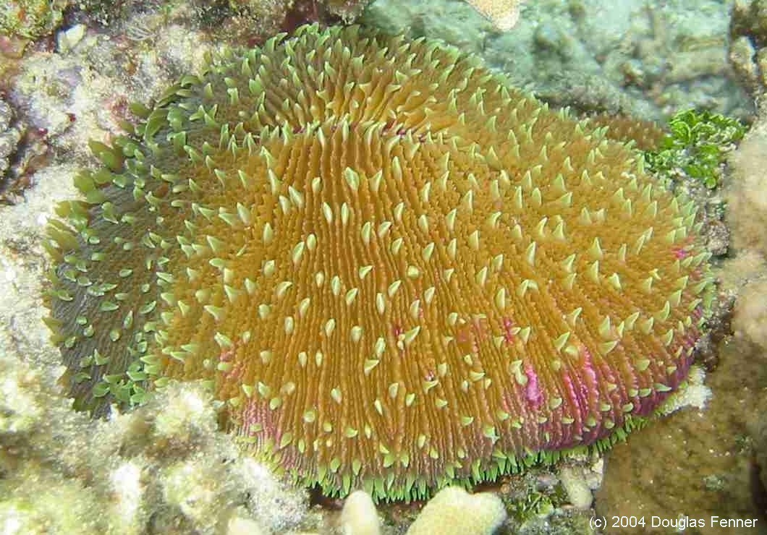

Slide 8
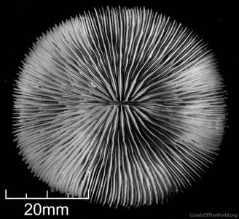
Skeleton: CaCO₃

