Slide 1
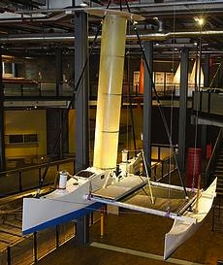
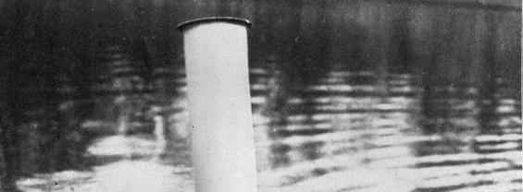
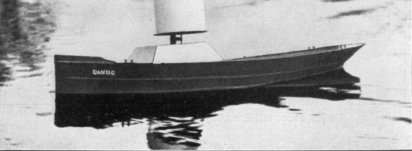
The Magnus Effect and the Flettner Rotor: the potential application for future Oceanic Shipping

Slide 2
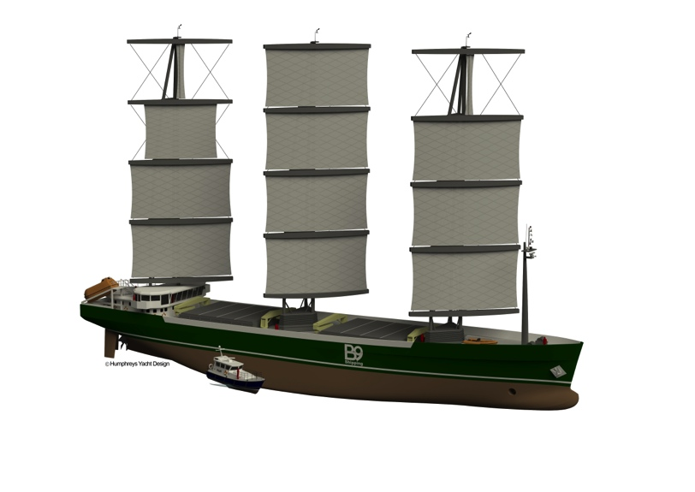
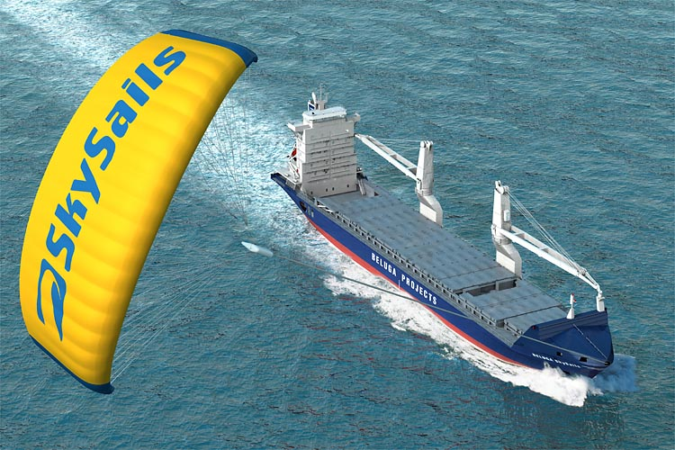
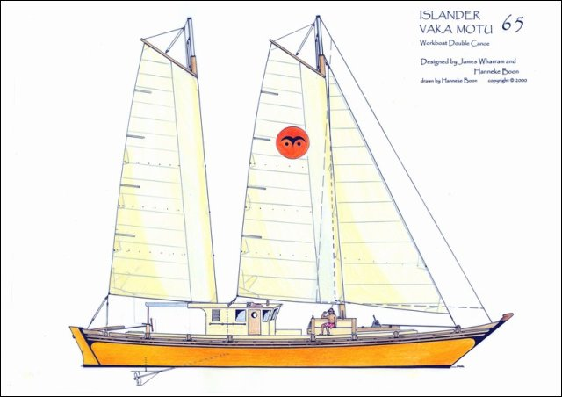
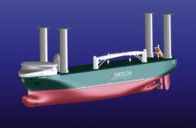
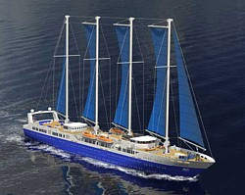
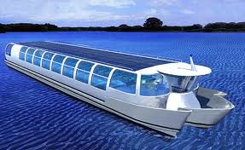
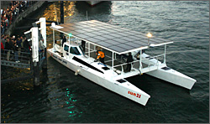
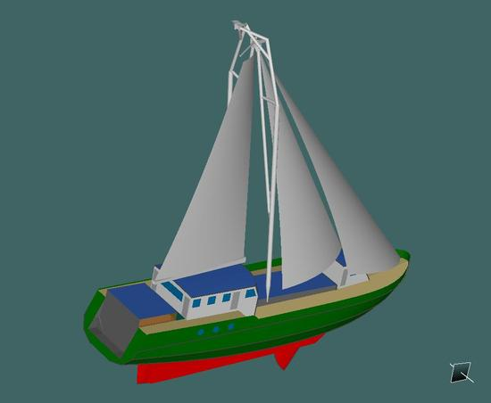
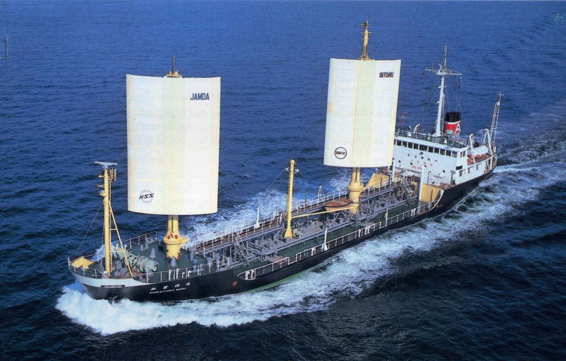
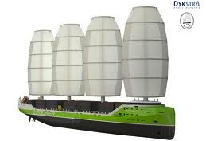

Slide 3
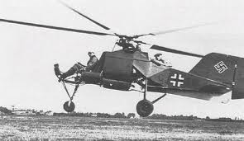
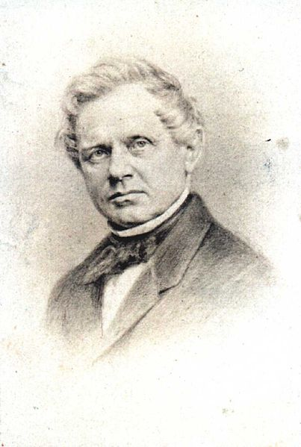
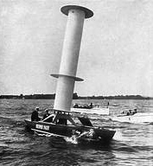
The Magnus Effect and the Flettner Rotor
In which a spinning cylinder past which an external stream is flowing receives a lateral thrust due to the lower pressure on the side of the cylinder where the cylinder’s motion is in the same direction as the streaming flow.
Heinrich Gustav Magnus (1802–1870) discovered a force that arises when air flows over a rotating body now called the Magnus Effect. It is the same effect that allows a baseball to curve in mid air.
A Flettner rotor is a rotating cylinder mounted upright on a ship and was invented by Anton Flettner (1885–1961). In sideways winds, the Magnus force generates a lift on the rotor, propelling the ship forward.

Slide 4
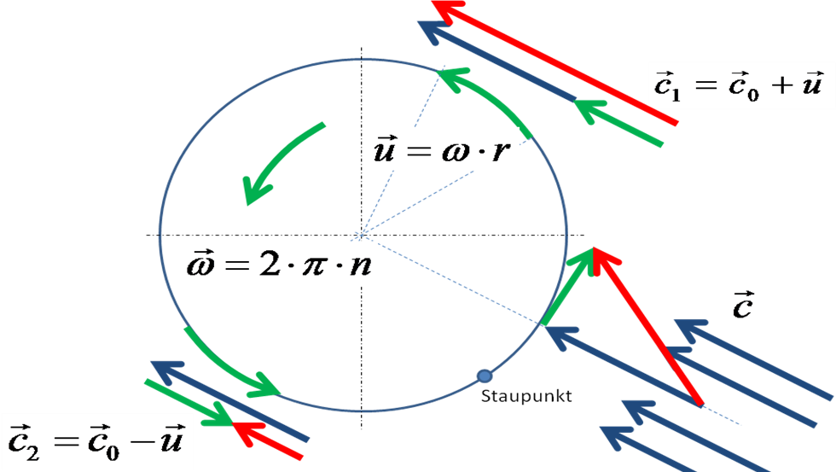
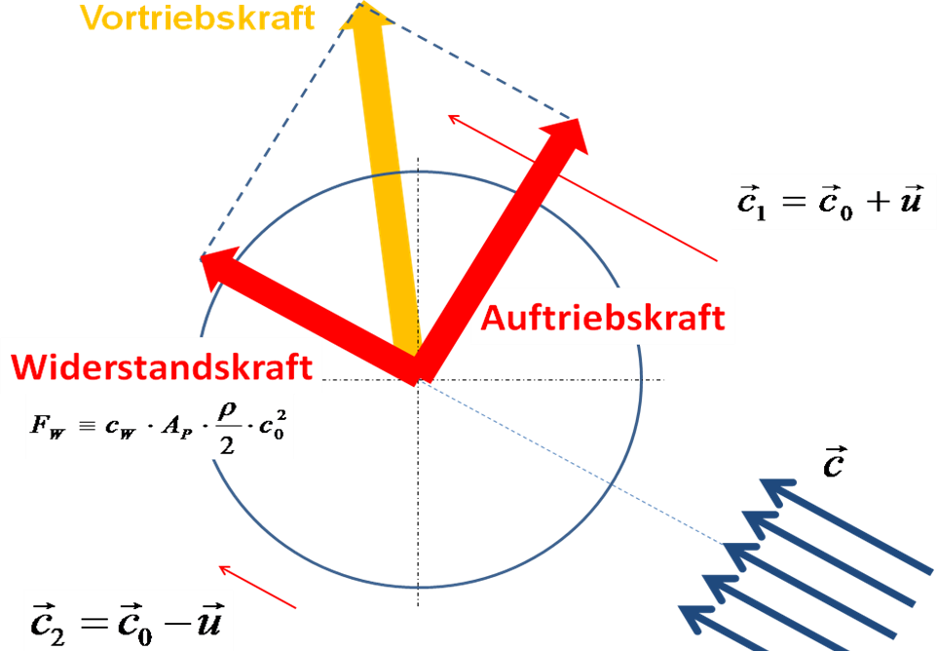

Slide 5
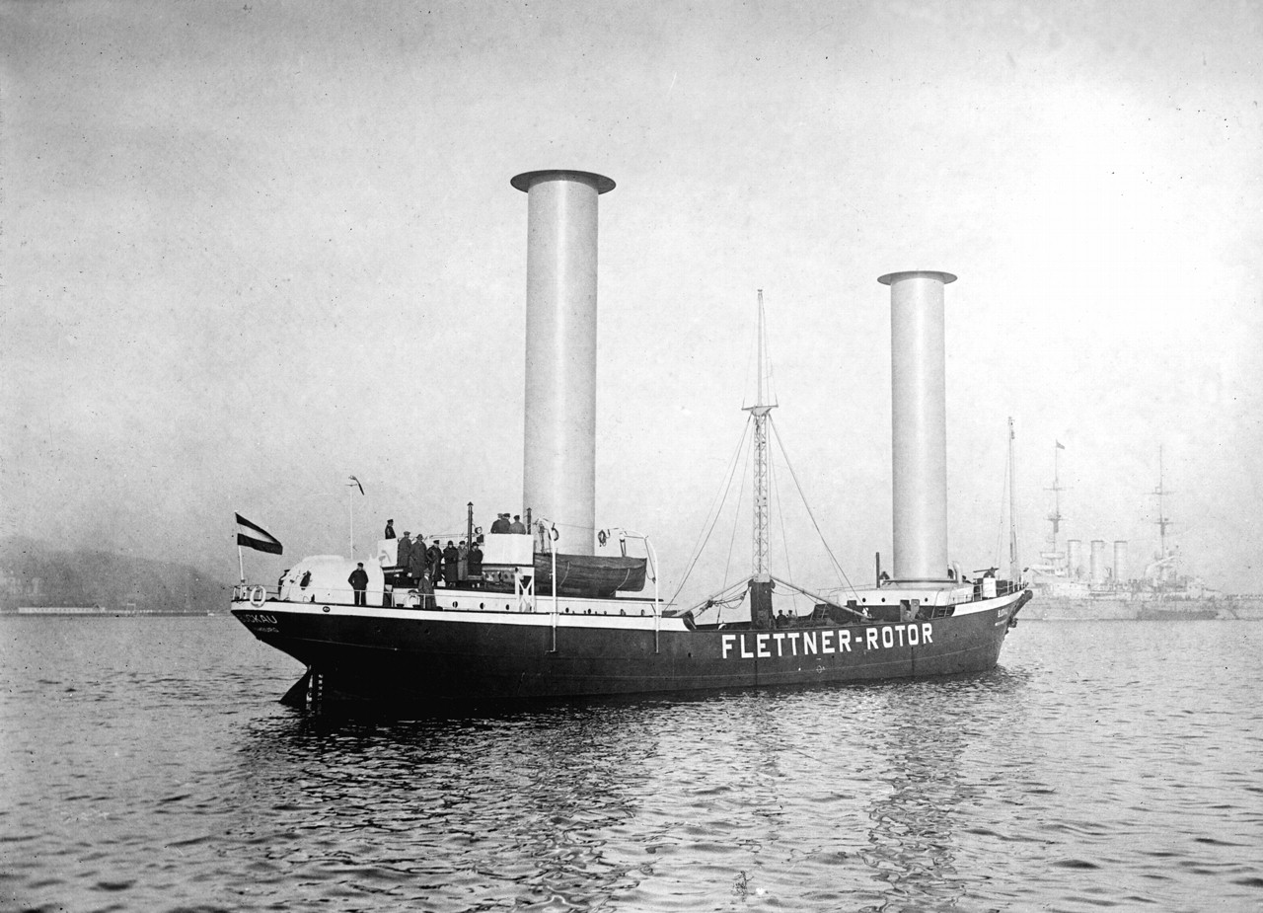
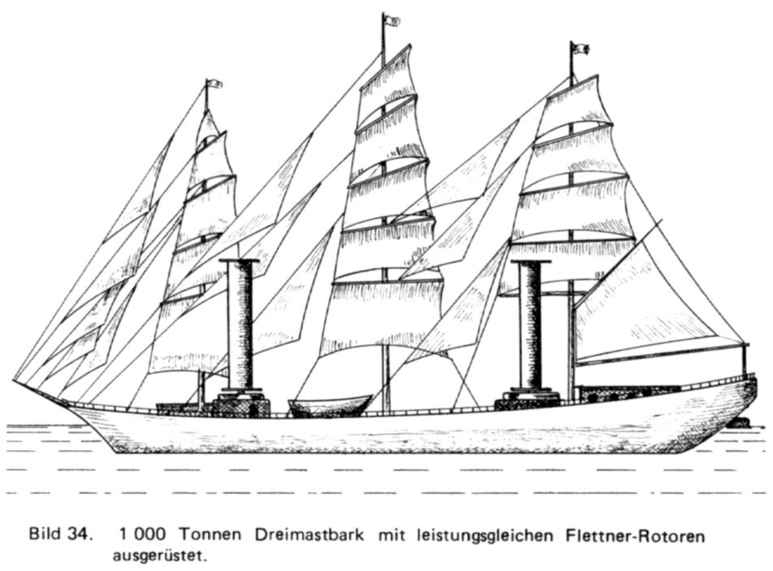

Slide 6
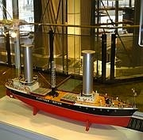
“the schooner Buckau recently put out to sea, a ship without sails or steam. Like a ghost ship it moved mysteriously through the water with no apparent means of propulsion.”
“The astounded spectators on shore knew that the boat was an old 2000-ton steel vessel and that previously 500 square yards of canvas had been needed to propel her.”
“Two strange cylinders, resembling giant smoke-stacks, rose from her deck. But no smoke was pouring from them and no engine noise was heard. There was no churning of screws. Yet the ship plowed its way through the rough waters of the Baltic, at nearly twice its former speed.”

Slide 7
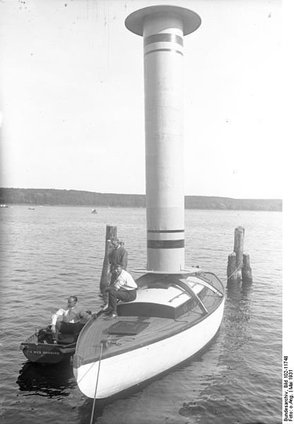

Slide 8
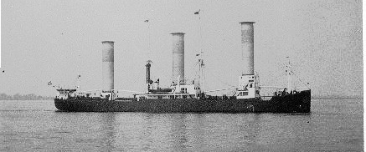
Barbara

Slide 9
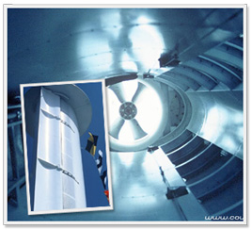

Slide 10
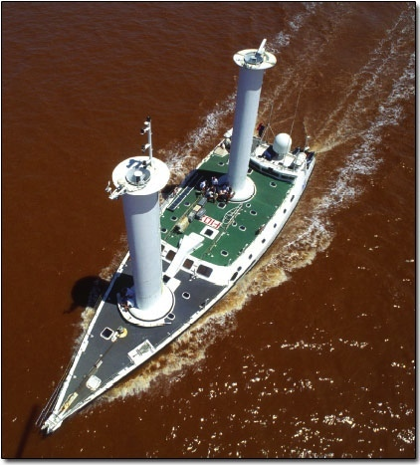
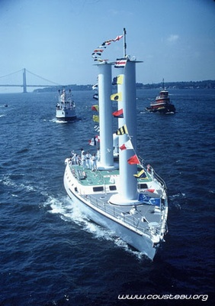
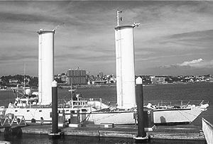

Slide 11
Tracker
42’, 18 ton motor vessel retrofitted with a Magnus Effect rotor 42” in diameter and 24’ high. It is driven up to about 600 rpm by a hydraulic motor which in turn is driven by a hydraulic pump turned by a small gas engine.

Slide 12
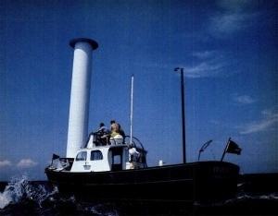
Power Mode | Av. Wind Speed (Knots) | Av. Boat Speed (Knots) | Av. Fuel Savings (%)
Rotor Assist | 16.1 | 7.0 | 44
Rotor Assist | 12.9 | 6.0 | 27
Rotor Sailing | 17.7 | 5.3 | 100

Slide 15
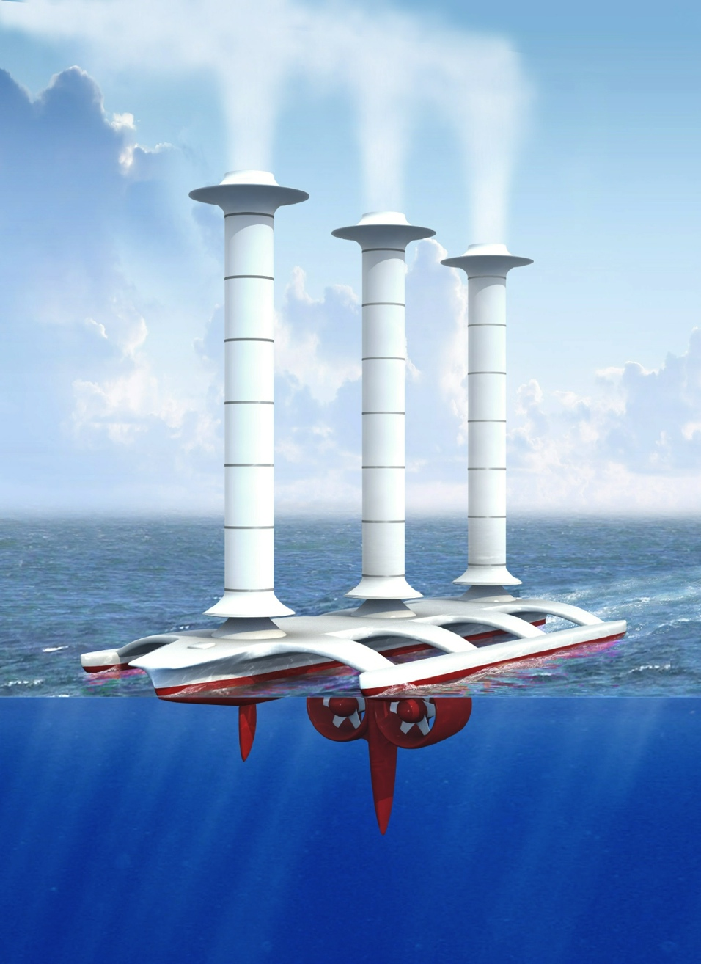
Notes:
A conceptual Flettner spray vessel with Thom fences. The wind would be blowing from the reader's right-hand side, the rotor spin would be clockwise seen from above and rotor thrust to the left. Vessels can also report sea and air temperatures, humidity, solar input, the direction and velocities of winds and currents, atmospheric pressure, visibility, cloud cover, plankton count, aerosol count, salinity, radio reception and could even rescue yachtsmen in distress (copyright © J. MacNeill 2006).

Slide 16
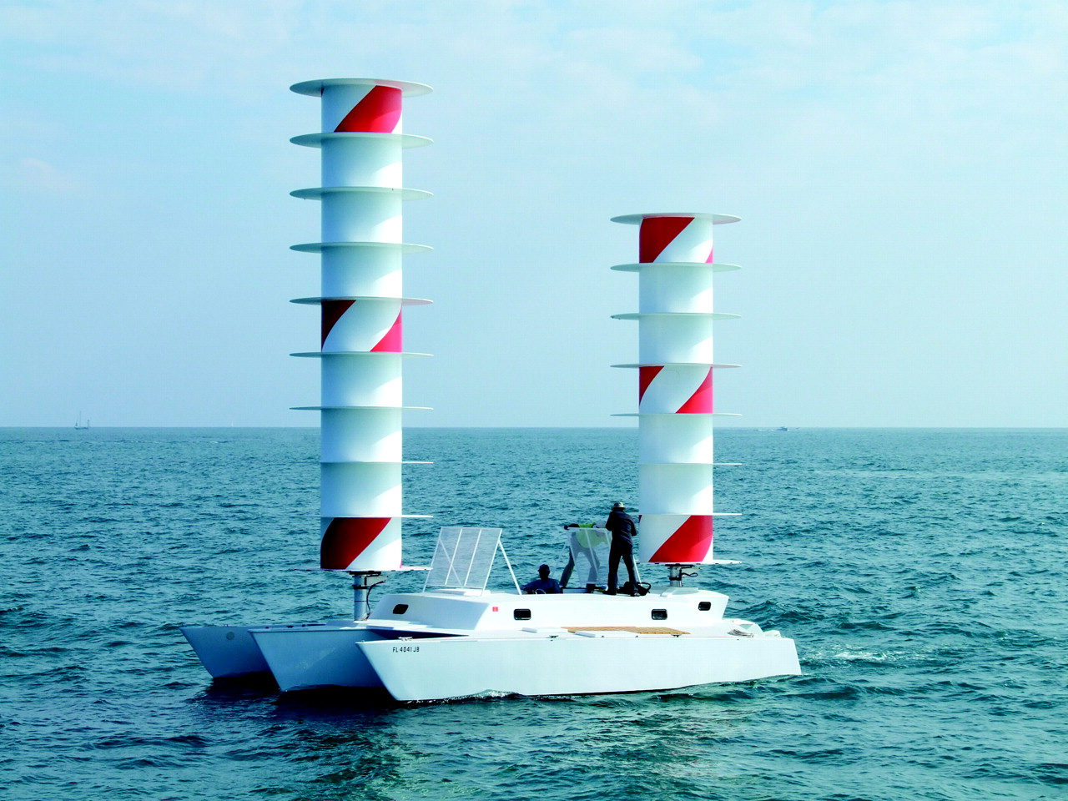
Notes:
John Marples' Cloudia (a rebuilt Searunner 34), with Thom fences on test at Fort Pierce, FL, February 2008. With a rotor drive power of 600 watts, she could sail faster than the beam wind, stop, go into reverse and yaw 180° in either direction about her own axis. Funding for work on Cloudia was provided by the Discovery Channel and organized by Impossible Pictures. © Discovery Channel.

Slide 17
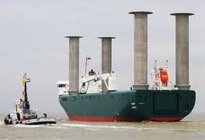

Slide 18
The Flettner Rotor – An Invention Ahead of Its Time? Special exhibition in the shipping section of the German Museum of Technology 2 February to 1 August 2010

Slide 19
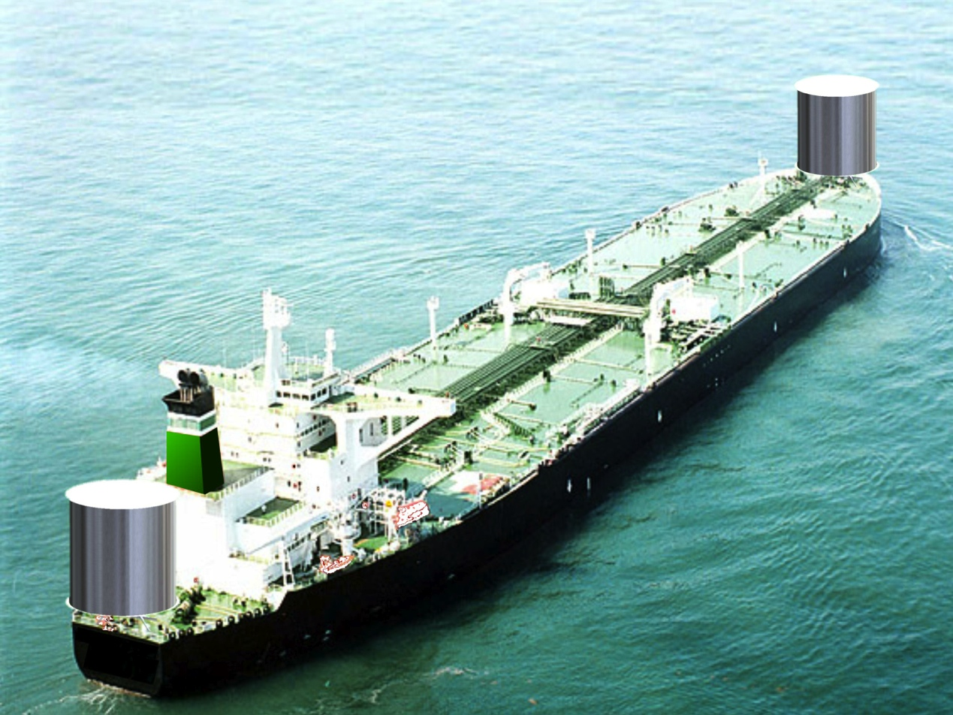
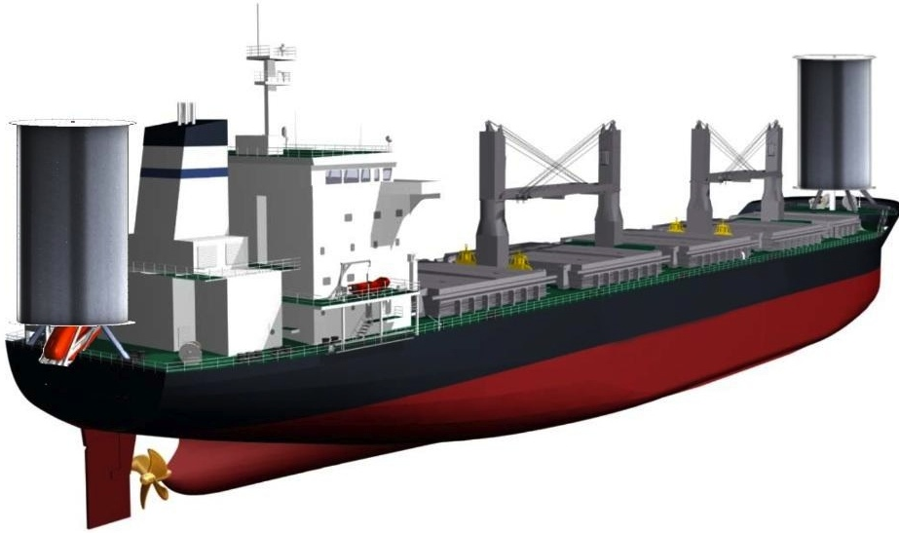

Slide 20
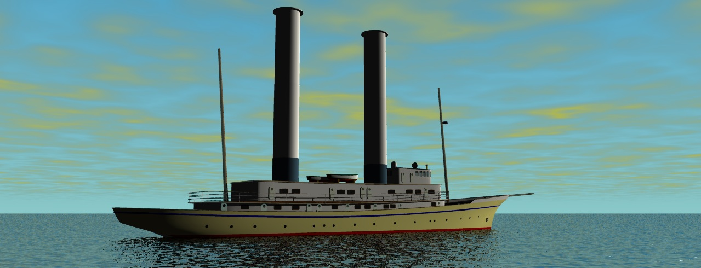

Slide 22
