Slide 1
Turning the Tide: transitioning to low carbon transport futures OCEANIA CENTRE FOR SUSTAINABLE TRANSPORT
Dr Peter Nuttall
Research Associate: University of the South Pacific

Slide 2
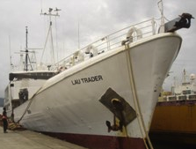
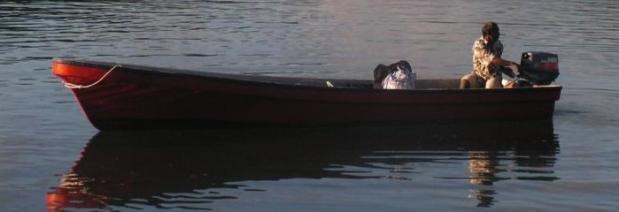
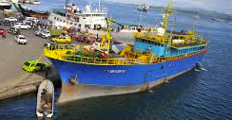
Notes:
This is a representative cross section of the current type of vessels servicing Fiji today. Ships are often old, poorly maintained and inefficient. Fuel represents a significant proportion of shipping operating costs, often the largest single cost. Accessing financing is difficult. This results in a vicious cycle of old ships being replaced with old ships, and the need for larger ships to achieve economies of scale. This, combined with narrow reef passages, small harbours and small cargos and numbers of passengers, leads to many routes being commercially marginal or even unviable. Governments are often required to subsidise or service these routes if communities are to have access to transport.

Slide 3
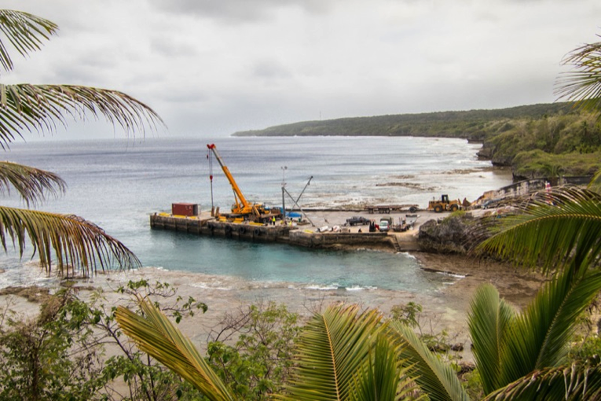
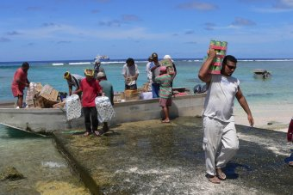
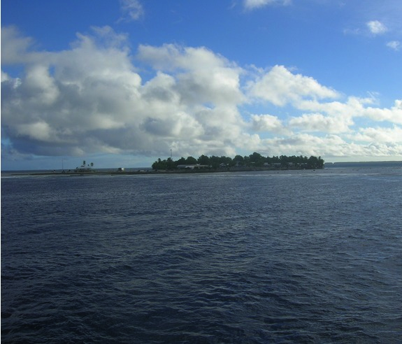
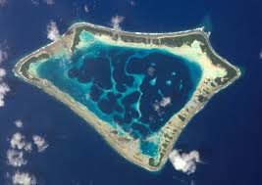
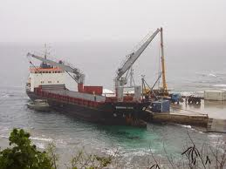
Notes:
Oceania represents arguably the region most dependent on sea transport. The island and atoll states of this maritime region face similar challenges in terms of finding sustainable solutions for transitioning to low carbon shipping. Similar issues exist for most SIDS, indeed for many coastal developing nation.
Sea transport, especially at the domestic level, has always presented a difficult issue to find long-term, sustainable, and cost-viable solutions for, even in periods of low fuel costs. The unique characteristics of Pacific shipping (minute economies, imbalance in inward/outward loadings, financing barriers, high operational risk, high infrastructural costs) present a greater challenge than for most other countries and regions.

Slide 4
The World burns about 17% of its fossil fuel on transport (the fastest growing sector)
The Pacific imports all its fossil fuel and burns 70%+ of that on transport.
The World divides its energy thinking into Electricity (Energy) and Transport. Electricity is its priority. When it thinks about transport as energy it mainly thinks about land transport.
This thinking is then transferred to the Pacific – through donor priorities, and imported ‘expert’ opinion.
$1billion+ for RE electricity.
$0 for sea transport
RMI only Pacific country to set target to reduce transport fuel use

Slide 6
Global Shipping Emissions Forecast

Slide 7
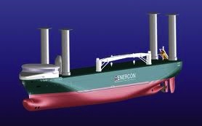
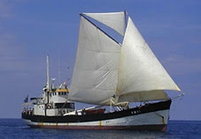
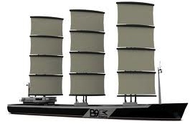
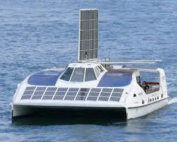
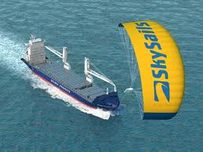
LNG; hydrogen, methane, biofuel, biogas, etc
Slow Steaming, Port efficiencies, Weather routing, Just-in-time, bulk fuel purchase, etc
ENERGY
TRANSPORT
MARINE
RENWABLE
ENERGY
EFFICENCY
Hull design, Propeller upgrade,
Waste heat recovery, etc
Notes:
orange pie graph
Inversely to global sector apportionment, transport uses some 70% of the total fuel imported regionally. The Pacific Island Countries and Territories’ fuel bill in 2013 was US$ 6.4 billion. This year it is one third of Fiji’s total imports. At the domestic level fuel imports remain a major drain on already scant national budgets. The high cost of transport hinders all development efforts. The longer producing a sustainable and more cost effective solution takes, the greater lost economic opportunity cost.
However, despite the identified need and the increasing availability of alternatives, meaningful measures have yet to eventuate. The focus across the region to reduce fuel dependency over the last decade has been almost exclusively on electricity generation. There has been no concerted programme to apply such priority to Pacific island sea transport. The barriers are complex and poorly understood.
Red Pie graph
In Fiji, for example transport accounts for more than 60% of all fuel used. Data capture and reliability is poor but sea transport is certainly the majority fuel user for some countries. Tuvalu, reported that 38% of total fuel imports or 64% of all transport fuel in 2012 was for maritime use. For countries like Tokelau, maritime fuel use could be as high as 90% of all use.
Blue pie graph
We do not have sufficient data to determine subsector level breakdowns for most countries. We have elected to focus on the domestic sea transport needs of countries and communities.
Purple Pie graph
The main options to reduce fuel use and emissions can be grouped into four categories – alternative fuels, operational efficiencies, technology advances and renewable energies.
The unique characteristics of the Pacific mean the options available to the global theatre are not necessarily the most accessible or appropriate. This is due to the characteristics of local demand; the Pacific merchant fleet (blue water but small and old, higher proportion of petrol to diesel); a lack of access to financing for new technologies; and the prohibitive cost and practicality of establishing extensive bunkering and support infrastructure for alternative fuels. There is considerable scope for operational efficiency improvements for both the current vessels and related infrastructure (port design and options, feeder transport networks, etc) and this will be true regardless of the fuel type used by shipping.
Green Pie graph
These same factors likely make renewable energy technologies more appropriate for a range of Pacific applications than at a global scale. Biofuels, from coconut oil and biomethanes, have strong potential, again especially for more isolated communities with high biomass availability.
There are numerous options available or emerging. Most global effort is on large scale vessels or high tech solutions for the developed world. We need the small scale and low cost versions.

Slide 8
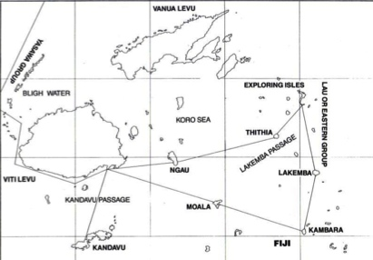
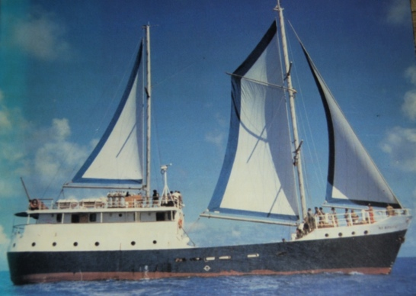
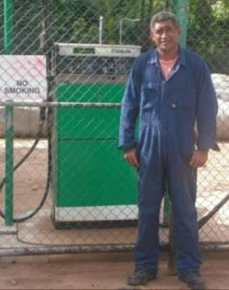
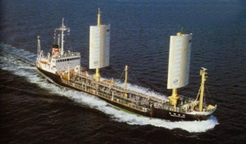
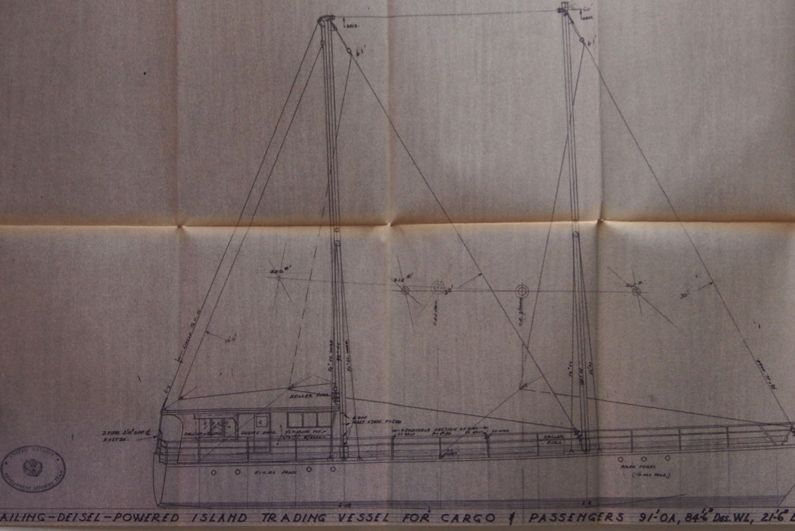
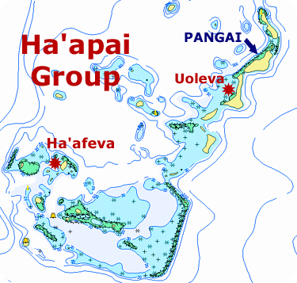
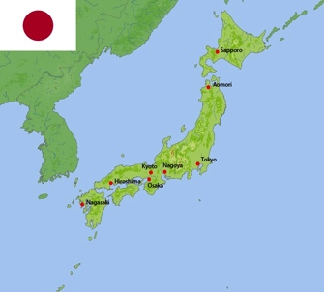
What happened in the last Oil Crisis?

Slide 9
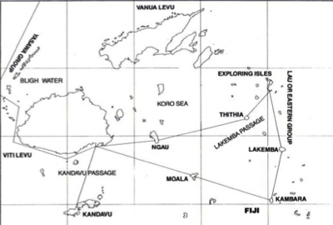
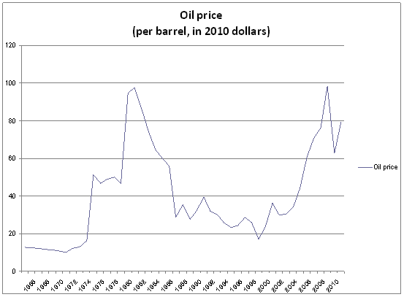
1984/86
23-30% fuel savings
30% reduced engine wear
Increased stability
Increased passenger comfort
Folding prop would have greatly increased fuel savings
IRR 127% on best routes
IRR 35% average routes
ADB funded $US40,000
What happened in the last Oil Crisis?
1983-86
30% fuel savings
Increased passage average speed from 12 -14 kts
Reduced crew downtime
Increased manoeuvrability
Could hold station in typhoon conditions
Trialled on 600-31000 tonne vessels
1982-85
UNESCAP/ADB funded needs assessment & analysis
Recommended network of trading catamarans and small energy efficient sail-freighter
Commissioned design for 92’ freighter carrying 30 T/30pax

Slide 10
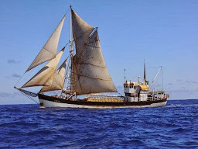
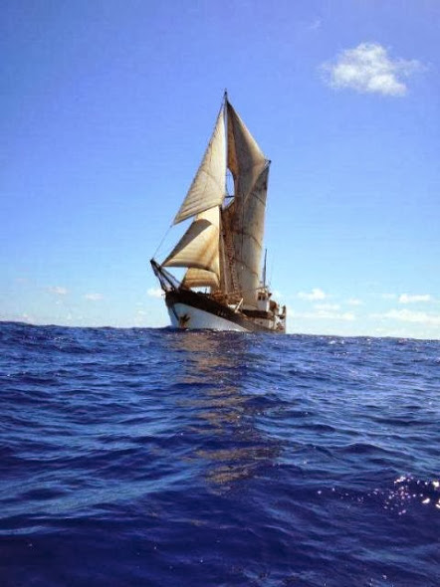
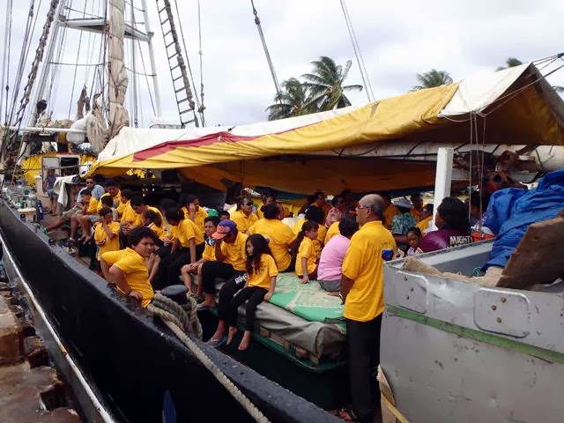
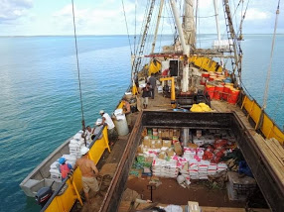
Notes:
This is the Kwai - She is the only commercial renewable energy assist vessel operating in our area today (outside tourist related vessels). It operates a tramp service between Hawaii through the Line Islands of Kiribati to the northern and southern Cook Islands. Saving around 35% of fuel, she is the only vessel that can afford to service many of these islands regularly. Without her these economies of these islands would be devastated. She has been providing proof of concept for 8 years. If these levels of savings and services can be provided with a 60 year old ship using 300 hundred year old technology what can be achieved with new vessels and new advances in technology.

Slide 12
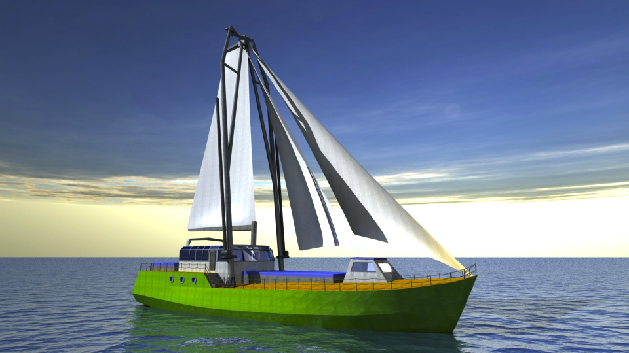
SV Greenheart

Slide 13
What would USP use a GreenHeart ship for? + A low carbon solution flagship + trailing Fiji- Tuvalu - Kiribati – Marshall trade+ Inter-campus transport of equipment, resources, teachers, students, researchers + Research, both into transport and marine + Sea service time for maritime cadets + Operational cost recovery
SV Greenheart

Slide 14
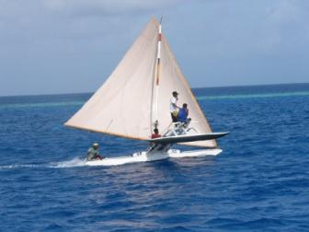
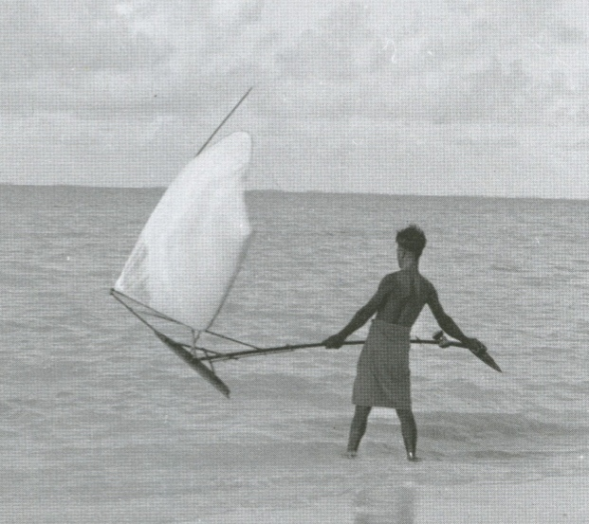
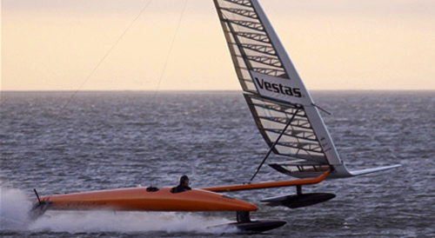

Slide 15
Turning the Tide: transitioning to low carbon transport futures OCEANIA CENTRE FOR SUSTAINABLE TRANSPORT
Dr Peter Nuttall
Research Associate: University of the South Pacific

